Slide 1
Special tribunal for the CRIME OF Aggression against ukraine: why, how, when?
Dr. Gabija Grigaitė – Daugirdė
Deputy minister of Justice, Lecturer at the Law faculty of Vilnius University
23rd Congress of the International Society for Military Law and the Law of War
VILNIUS

Slide 2
WHY?
The law demands responsibility: from the right to wage war to the comprehensive prohibition on the use of force in the UN Charter
From state responsibility to individual criminal responsibility for the crime of aggression in international criminal law: Nuremberg and Tokyo tribunals
Conditions for effectiveness of international criminal law: clear norm, institutional framework and commitment to punish all violations (selectivity in enforcement?)
Impunity gap: limits in ICC‘s jurisdiction over the crime of aggression (possible amendments of the Rome Statute?)
The need and importance of a strong precedent: manifest violation of the UN Charter (imperial character, scale and gravity) being condemned by UN GA and other organisations

Slide 3
HOW?
Different objectives – different models
Different models – different legitimacy
Applicability of personal immunities – the issue surrounding all the models
International tribunal versus Ukrainian court with international support (so called hybrid): issues of legality and legitimacy
Regional as international (endorsement of UN GA?) or international as regional (cross-regional support): possible role of Council of Europe as a way forward
Treaty between states (Joint investigation team (Eurojust) countries and UA)
Transfer of jurisdiction model (European External Action Service proposal based on MH17 precedent)
Nuremberg is an example how history and truth can be manipulated through the legal process if the legal process is not done in the right way.

Slide 4
WHEN?
Decision on the establishment of the Nuremberg tribunal – 1942 January 13 St James Declaration in London. In 1946 September 30 tribunal was established.
More than 2 years of the full-scale aggression against Ukraine, more than 10 years from the annexation of Crimea – too late or too early?
First procedural steps - interim office of prosecution - International Centre for the Prosecution of the Crime of Aggression Against Ukraine (ICPA): its role and mandate
Other procedural steps needed for the establishment and cross-regional support
UA victory as a prerequisite for the establishment of the Special Tribunal?
"We have the means and the capacity to deal with our problems, if only we can find the political will” — Kofi Annan

Slide 5
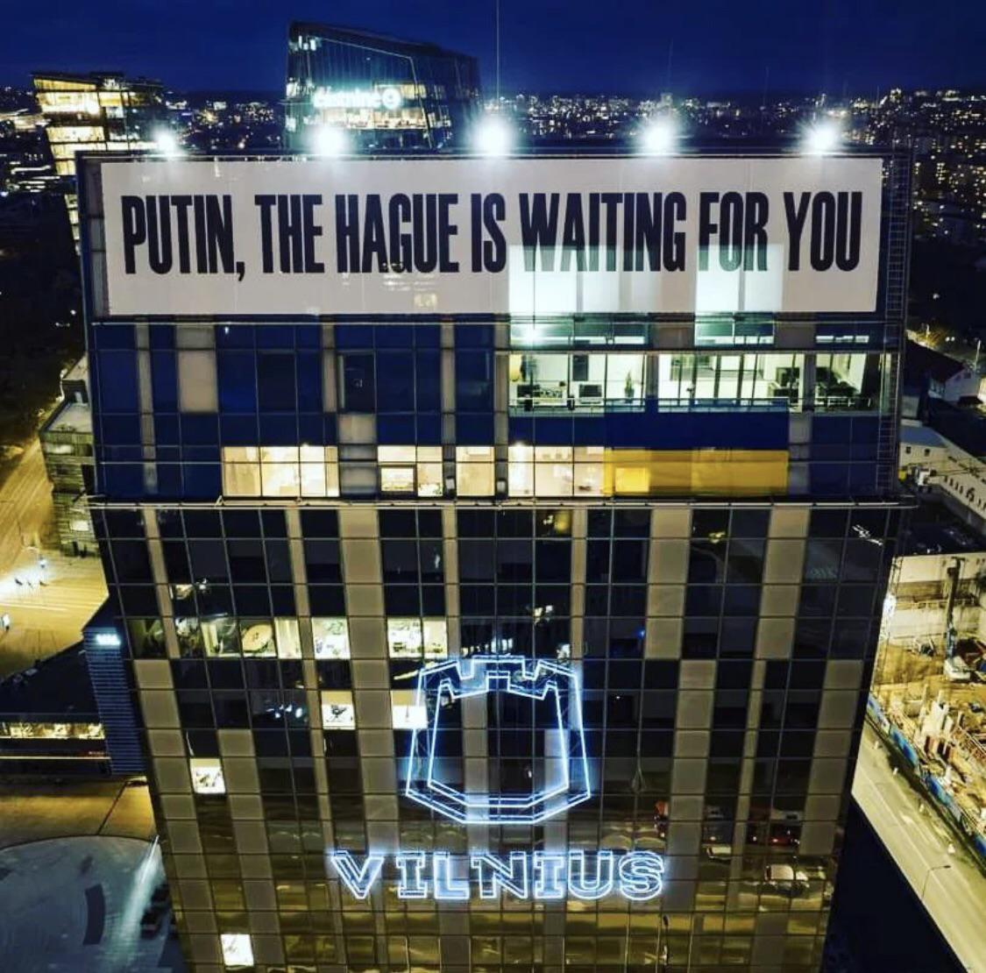
Thank You!
Follow me on Linkedin for updates:
Gabija Grigaite-Daugirde, PhD
Or X: @GGDaugirde

