Slide 1
Increasing the Legal Resilience of Critical Offshore Infrastructure in the Context of Hybrid Warfare
Alexander Lott
International Society for Military Law and the Law of War 23rd Congress
Panel: Covert and Hybrid Activities and the Law
Vilnius, 23 May 2024

Slide 2
Vulnerability of Submarine Cables
In April 2021, a fiber-optic cable connecting the Norwegian Svalbard archipelago and the mainland of northern Norway was cut and a long section of the cable removed.
In January 2022, another cable connecting the mainland coast of Norway and Svalbard was damaged.
September 2022: The Nord Stream explosions
In October 2022, a cable connecting the Shetland Islands and the Danish Faroe Islands is broken.
On 19 October 2022, at least three fiber-optic cables that reportedly connected Marseille to Lyon, Milan, and Barcelona were cut off the French coast.
On 20 October 2022, a cable connecting the British Shetland Islands to the rest of the UK communications system was cut in two sections because of which Shetland Islands briefly lost telephone and Internet services.
In February 2023, Taiwan announced that two of its cross-strait submarine cables were cut.
October 2023: Balticconnector incident in the Gulf of Finland + 3 submarine cables damaged.
February 2024: Four submarine communications cables that connect Europe and Asia damaged in the Red Sea presumably by the Houthi militia leading to disruptions in Internet services.

Slide 3
The Concept of Hybrid Warfare

Slide 4
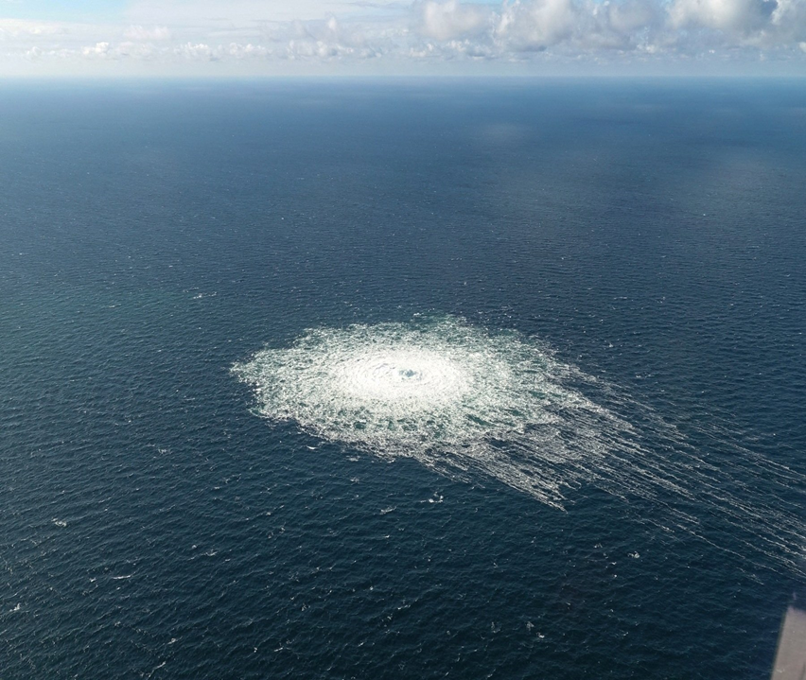
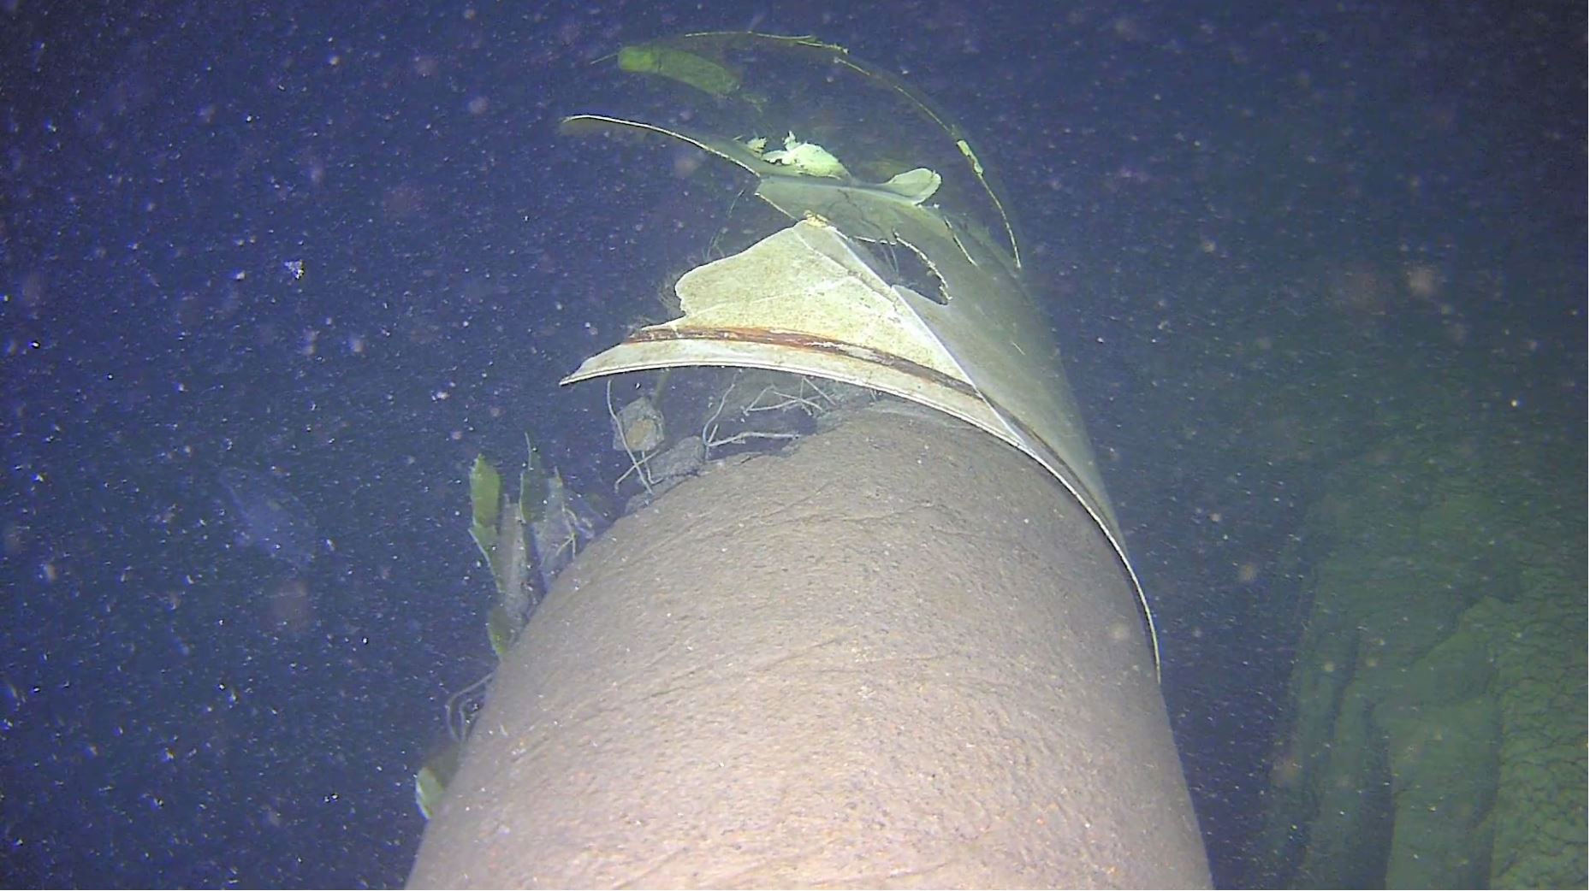
Vulnerability of Submarine Pipelines
Nord Stream 1 and 2 explosions of September 2022
Balticconnector incident of October 2023
Source: The Finnish Border Guard

Slide 5
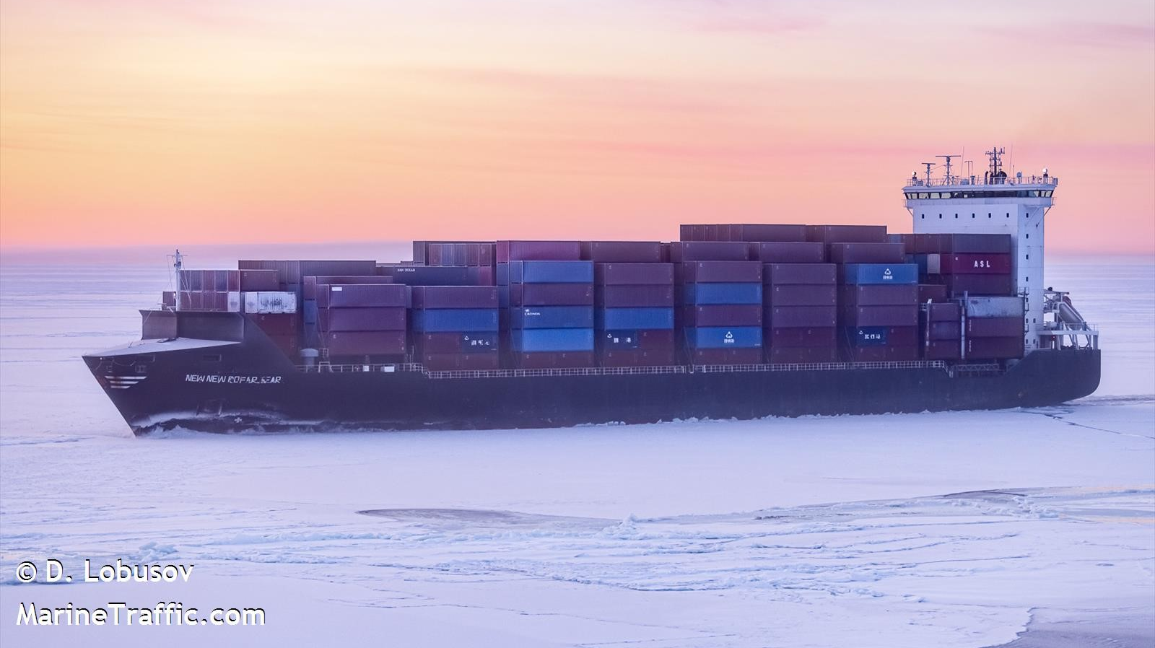
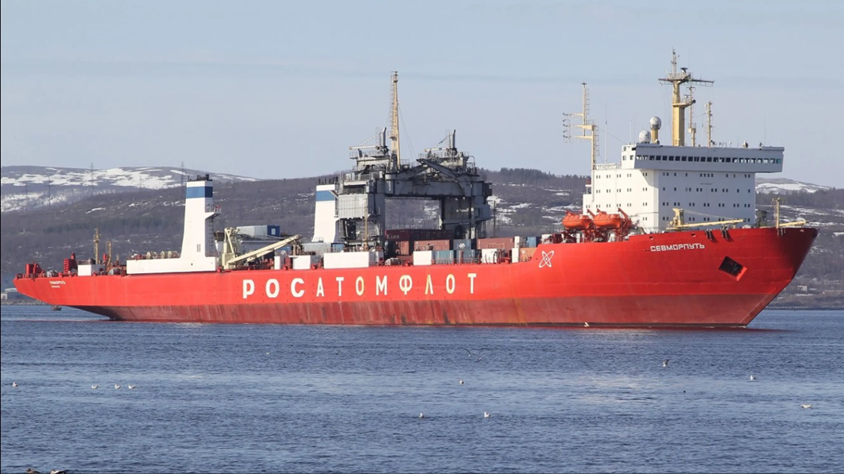
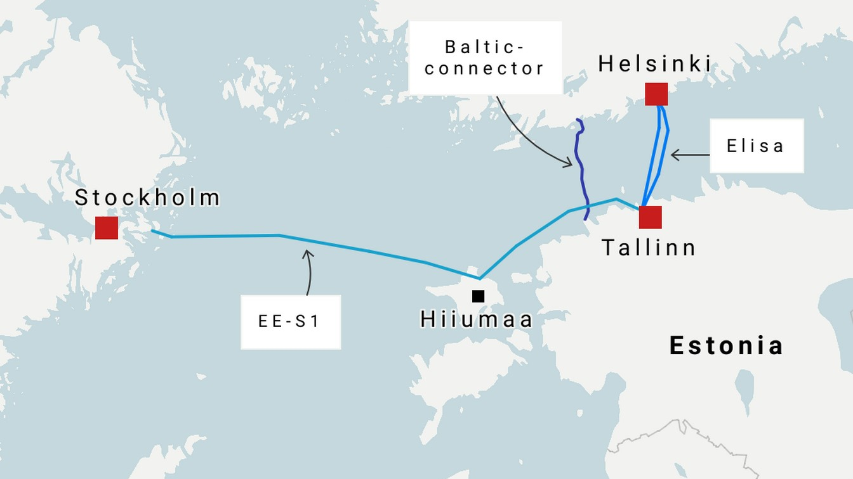
Rule 37 of the San Remo Manual:
Belligerents shall take care to avoid damage to cables and pipelines laid on the sea-bed which do not exclusively serve the belligerents.
Newport Manual: ““there are no discernible rules” against a belligerent targeting neutral commercial submarine cables used by the enemy.”

Slide 6
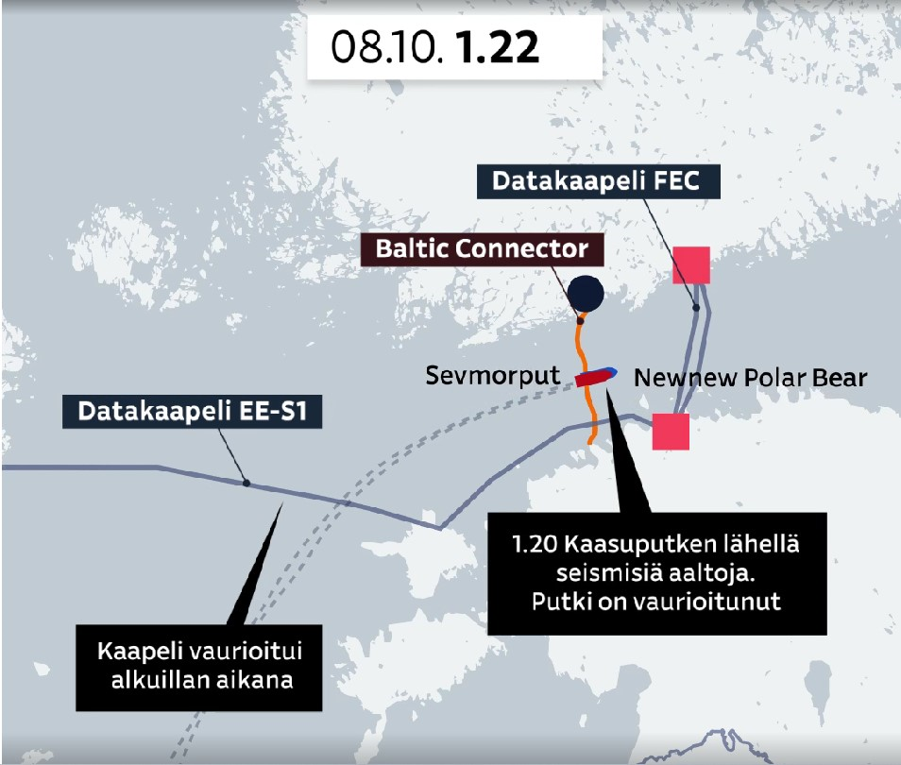

Slide 7
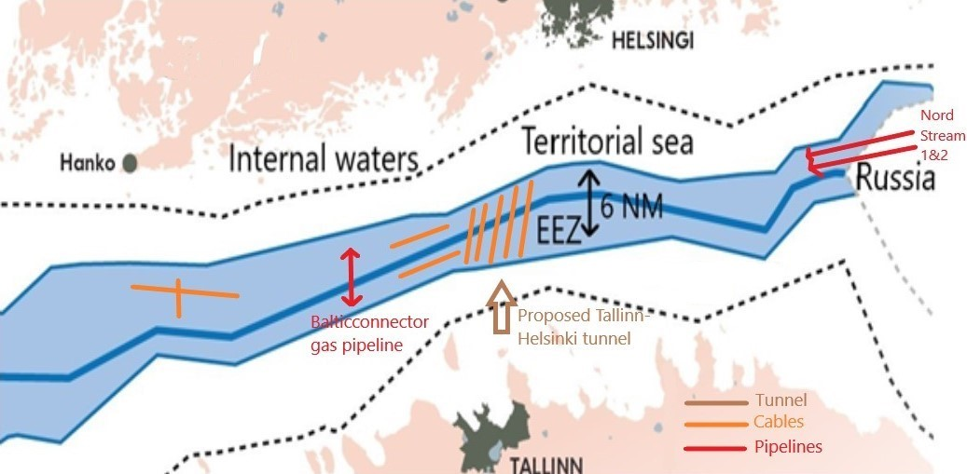
The EEZ Corridor and Infrastructure in the Gulf of Finland (Viro Strait)

Slide 8
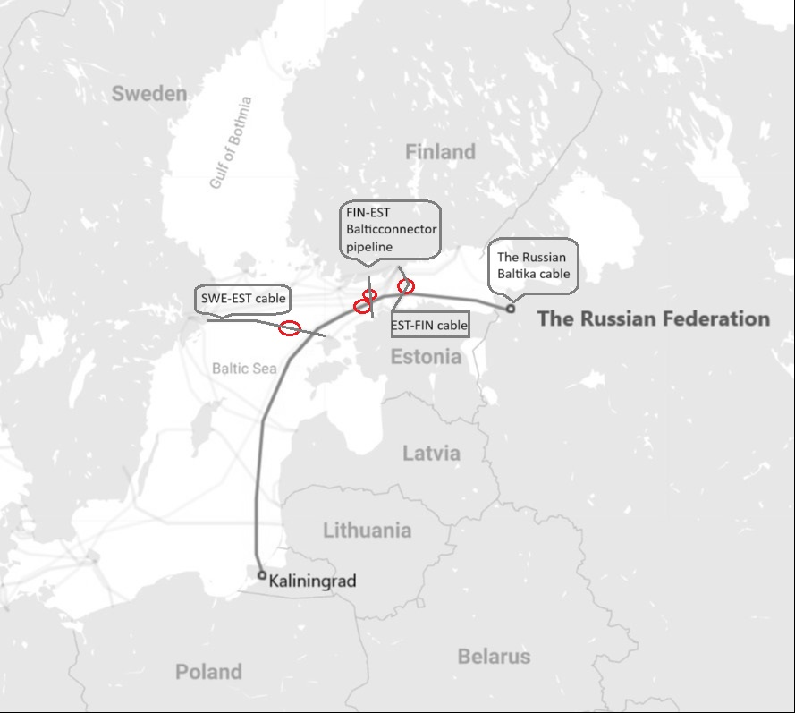

Slide 9
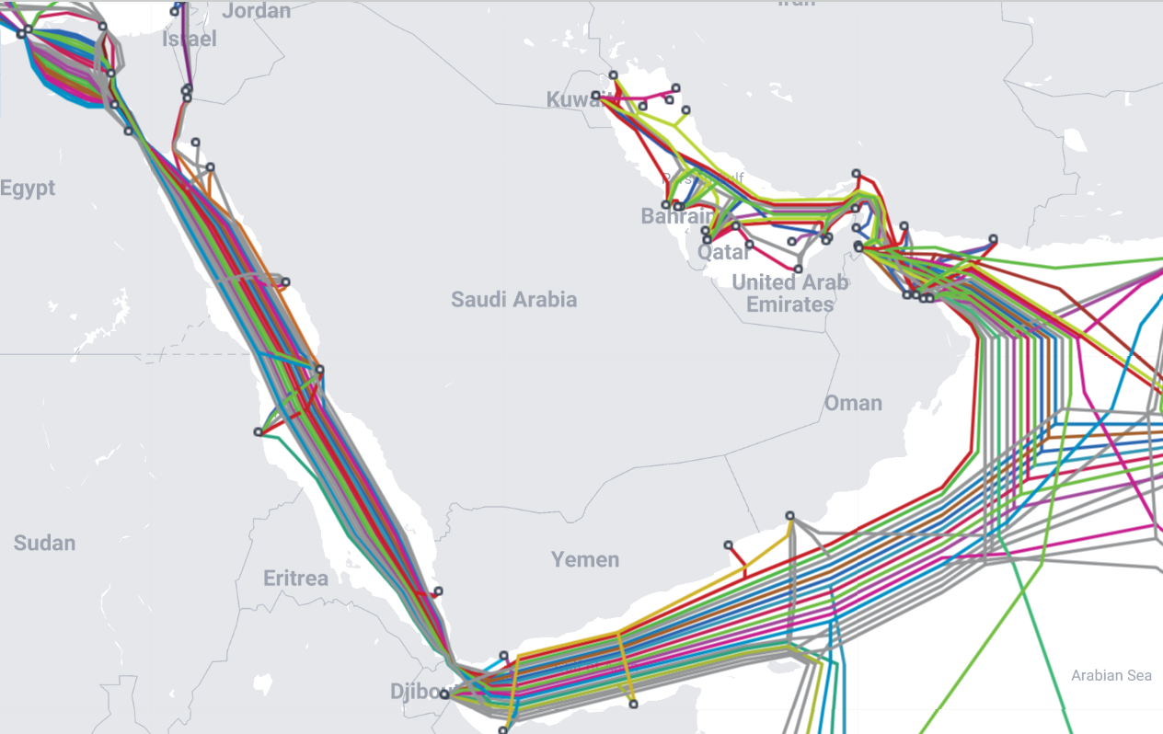
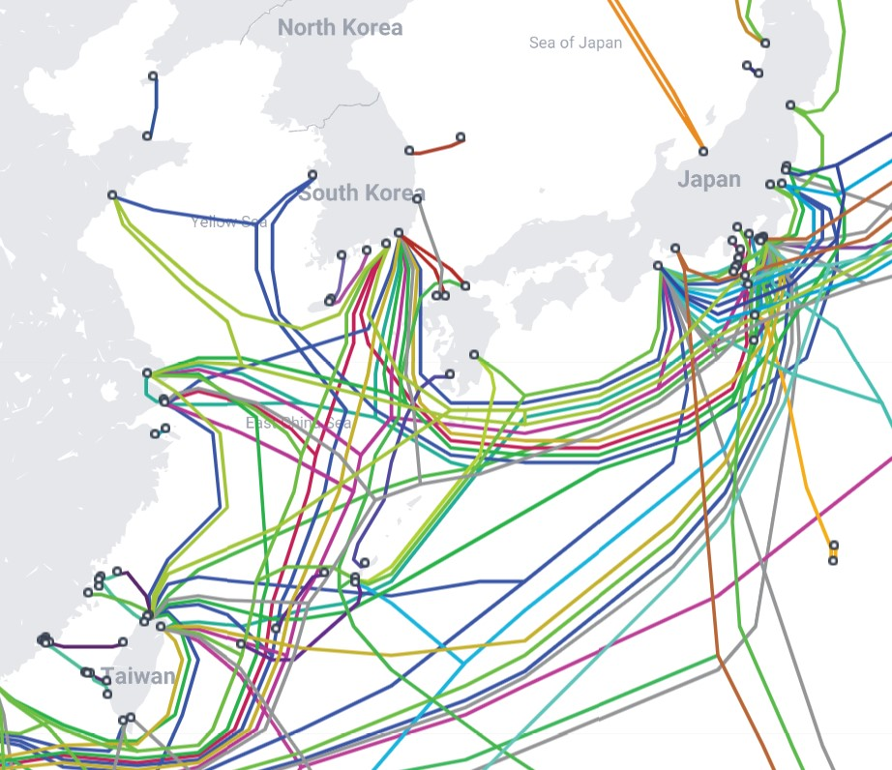

Slide 10
Thanks for your attention!
Questions?
Alexander Lott
alexander.lott@uit.no

