Slide 1
The Use of Force Against or Defence of Merchant Ships and the Regime of International Straits Applied in an Operational Context
Alexander Lott & Magne Frostad
International Society for Military Law and the Law of War 23rd Congress
Vilnius, 24 May 2024

Slide 2
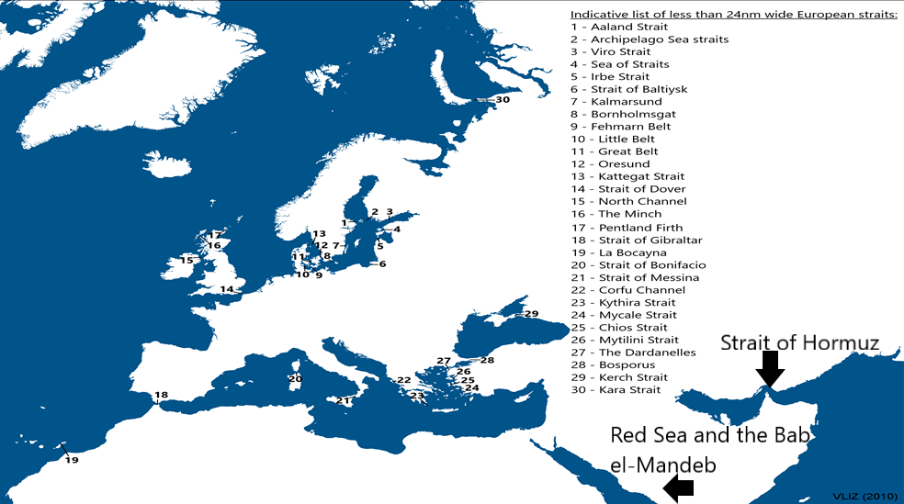

Slide 3
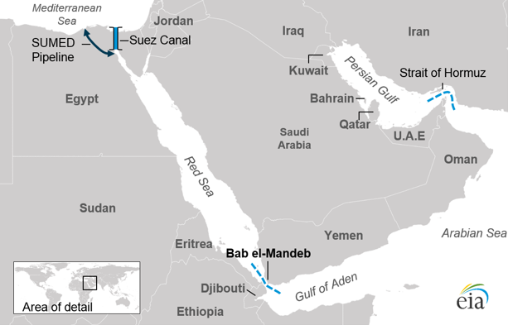

Slide 4
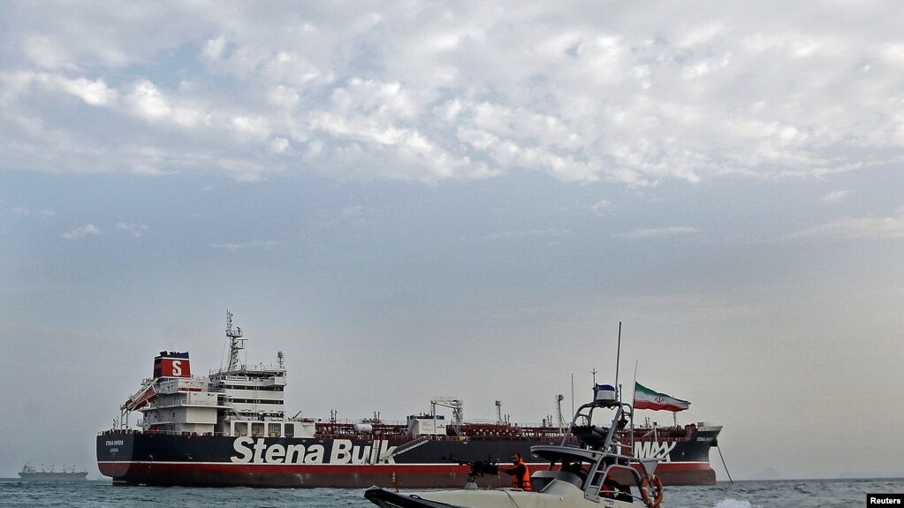
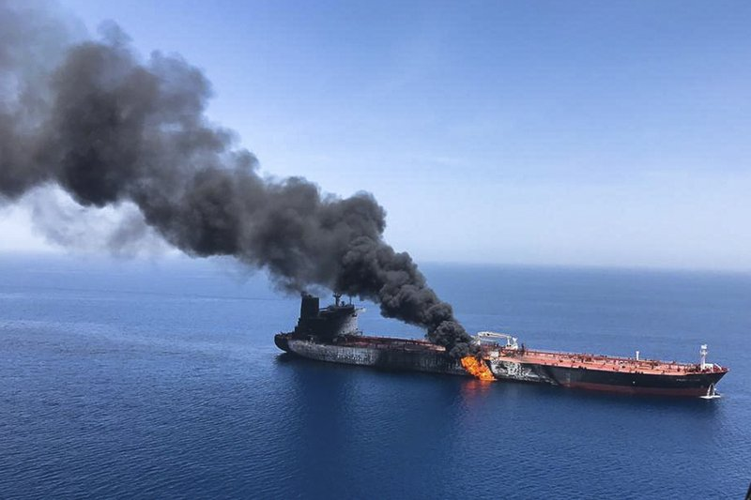
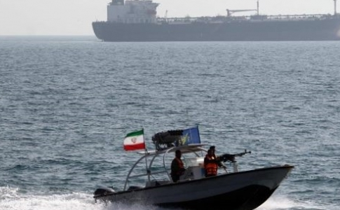
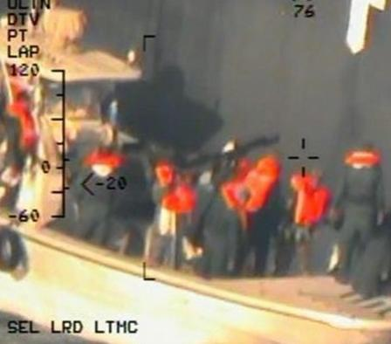
The Strait of Hormuz Incidents

Slide 6
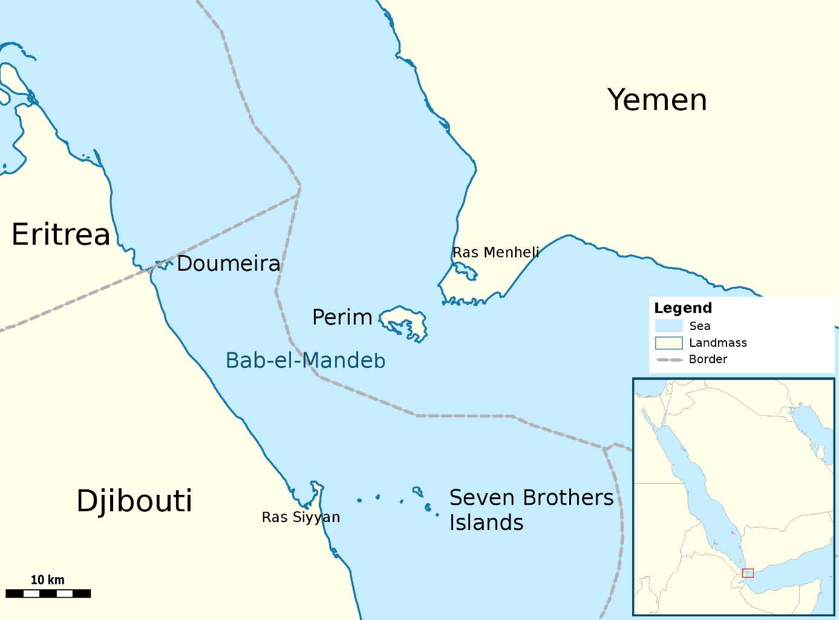

Slide 7
Rules 27 and 28 of the San Remo Manual
Rule 27. The rights of transit passage and archipelagic sea lanes passage applicable to international straits and archipelagic waters in peacetime continue to apply in times of armed conflict. The laws and regulations of States bordering straits and archipelagic States relating to transit passage and archipelagic sea lanes passage adopted in accordance with general international law remain applicable.
Rule 28. Belligerent and neutral surface ships, submarines and aircraft have the rights of transit passage and archipelagic sea lanes passage through, under, and over all straits and archipelagic waters to which these rights generally apply.

Slide 8
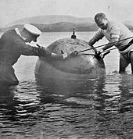
The Corfu Channel Case

Slide 9
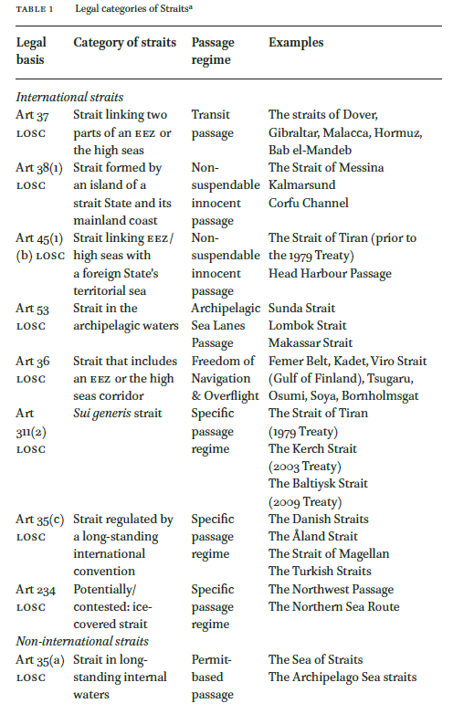
Parallel passage regimes in the Strait of Hormuz?
UNCLOS States Parties: transit passage.
Non-SP to UNCLOS: non-suspendable innocent passage?
Any room for permit-based passage?
Rather not.
Art 35(a) criteria not met.
Key question: whether transit passage forms part of CIL?

Slide 10
Finding a mandate for using armed force against the Houthis due to their attacks on merchant and naval vessels
The need for an exception to the general prohibition on the use of force in UNC Art. 2(4)
Possible exceptions
UNSC Res. 2722 (2024) – no
By invitation of the Presidential Leadership Council – not re January attacks, perhaps afterwards
Self-defense
Naval vessels – ok
Merchant vessels – …

Slide 11
Can an attack on a merchant vessel constitute an armed attack under the right to self-defense (UNC Art. 51)?
How has the issue been regulated in treaties, or under the rules established therein?
1945 UN Charter (UNSC mandates)
1949 NATO-treaty
2001 ICC Statute
State practice and opinio juris
1974 UNGA Definition of Aggression Declaration, Art. 3(d): “An attack by the armed forces of a State on the land, sea or air forces, or marine and air fleets of another State”
E.g. Mexico (1958), US (1975), US/UK (1980s)
Case law
2003 ICJ Oil Platforms case
Legal literature

Slide 12
Thank you for your attention!

