Slide 1
Newport Manual on the Law of Naval Warfare
Professor Pete Pedrozo
Howard S. Levie Chair on the Law of Armed Conflict
Notes:
Pandemic project

Slide 2
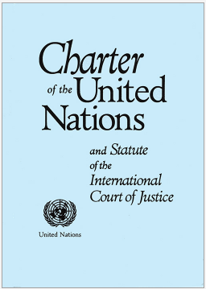
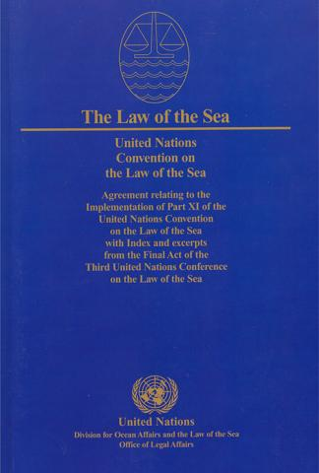
Criticisms on the Law of Naval Warfare
Law of Naval Warfare is outdated in the Post-Charter era
Conflates jus ad bellum and jus in bello
Law of Navel Warfare is outdated in the Post-UNCLOS era
Conflates peacetime law of the sea with wartime law of naval warfare
Need a new treaty
Existing treaties and State practice are sufficient

Slide 3
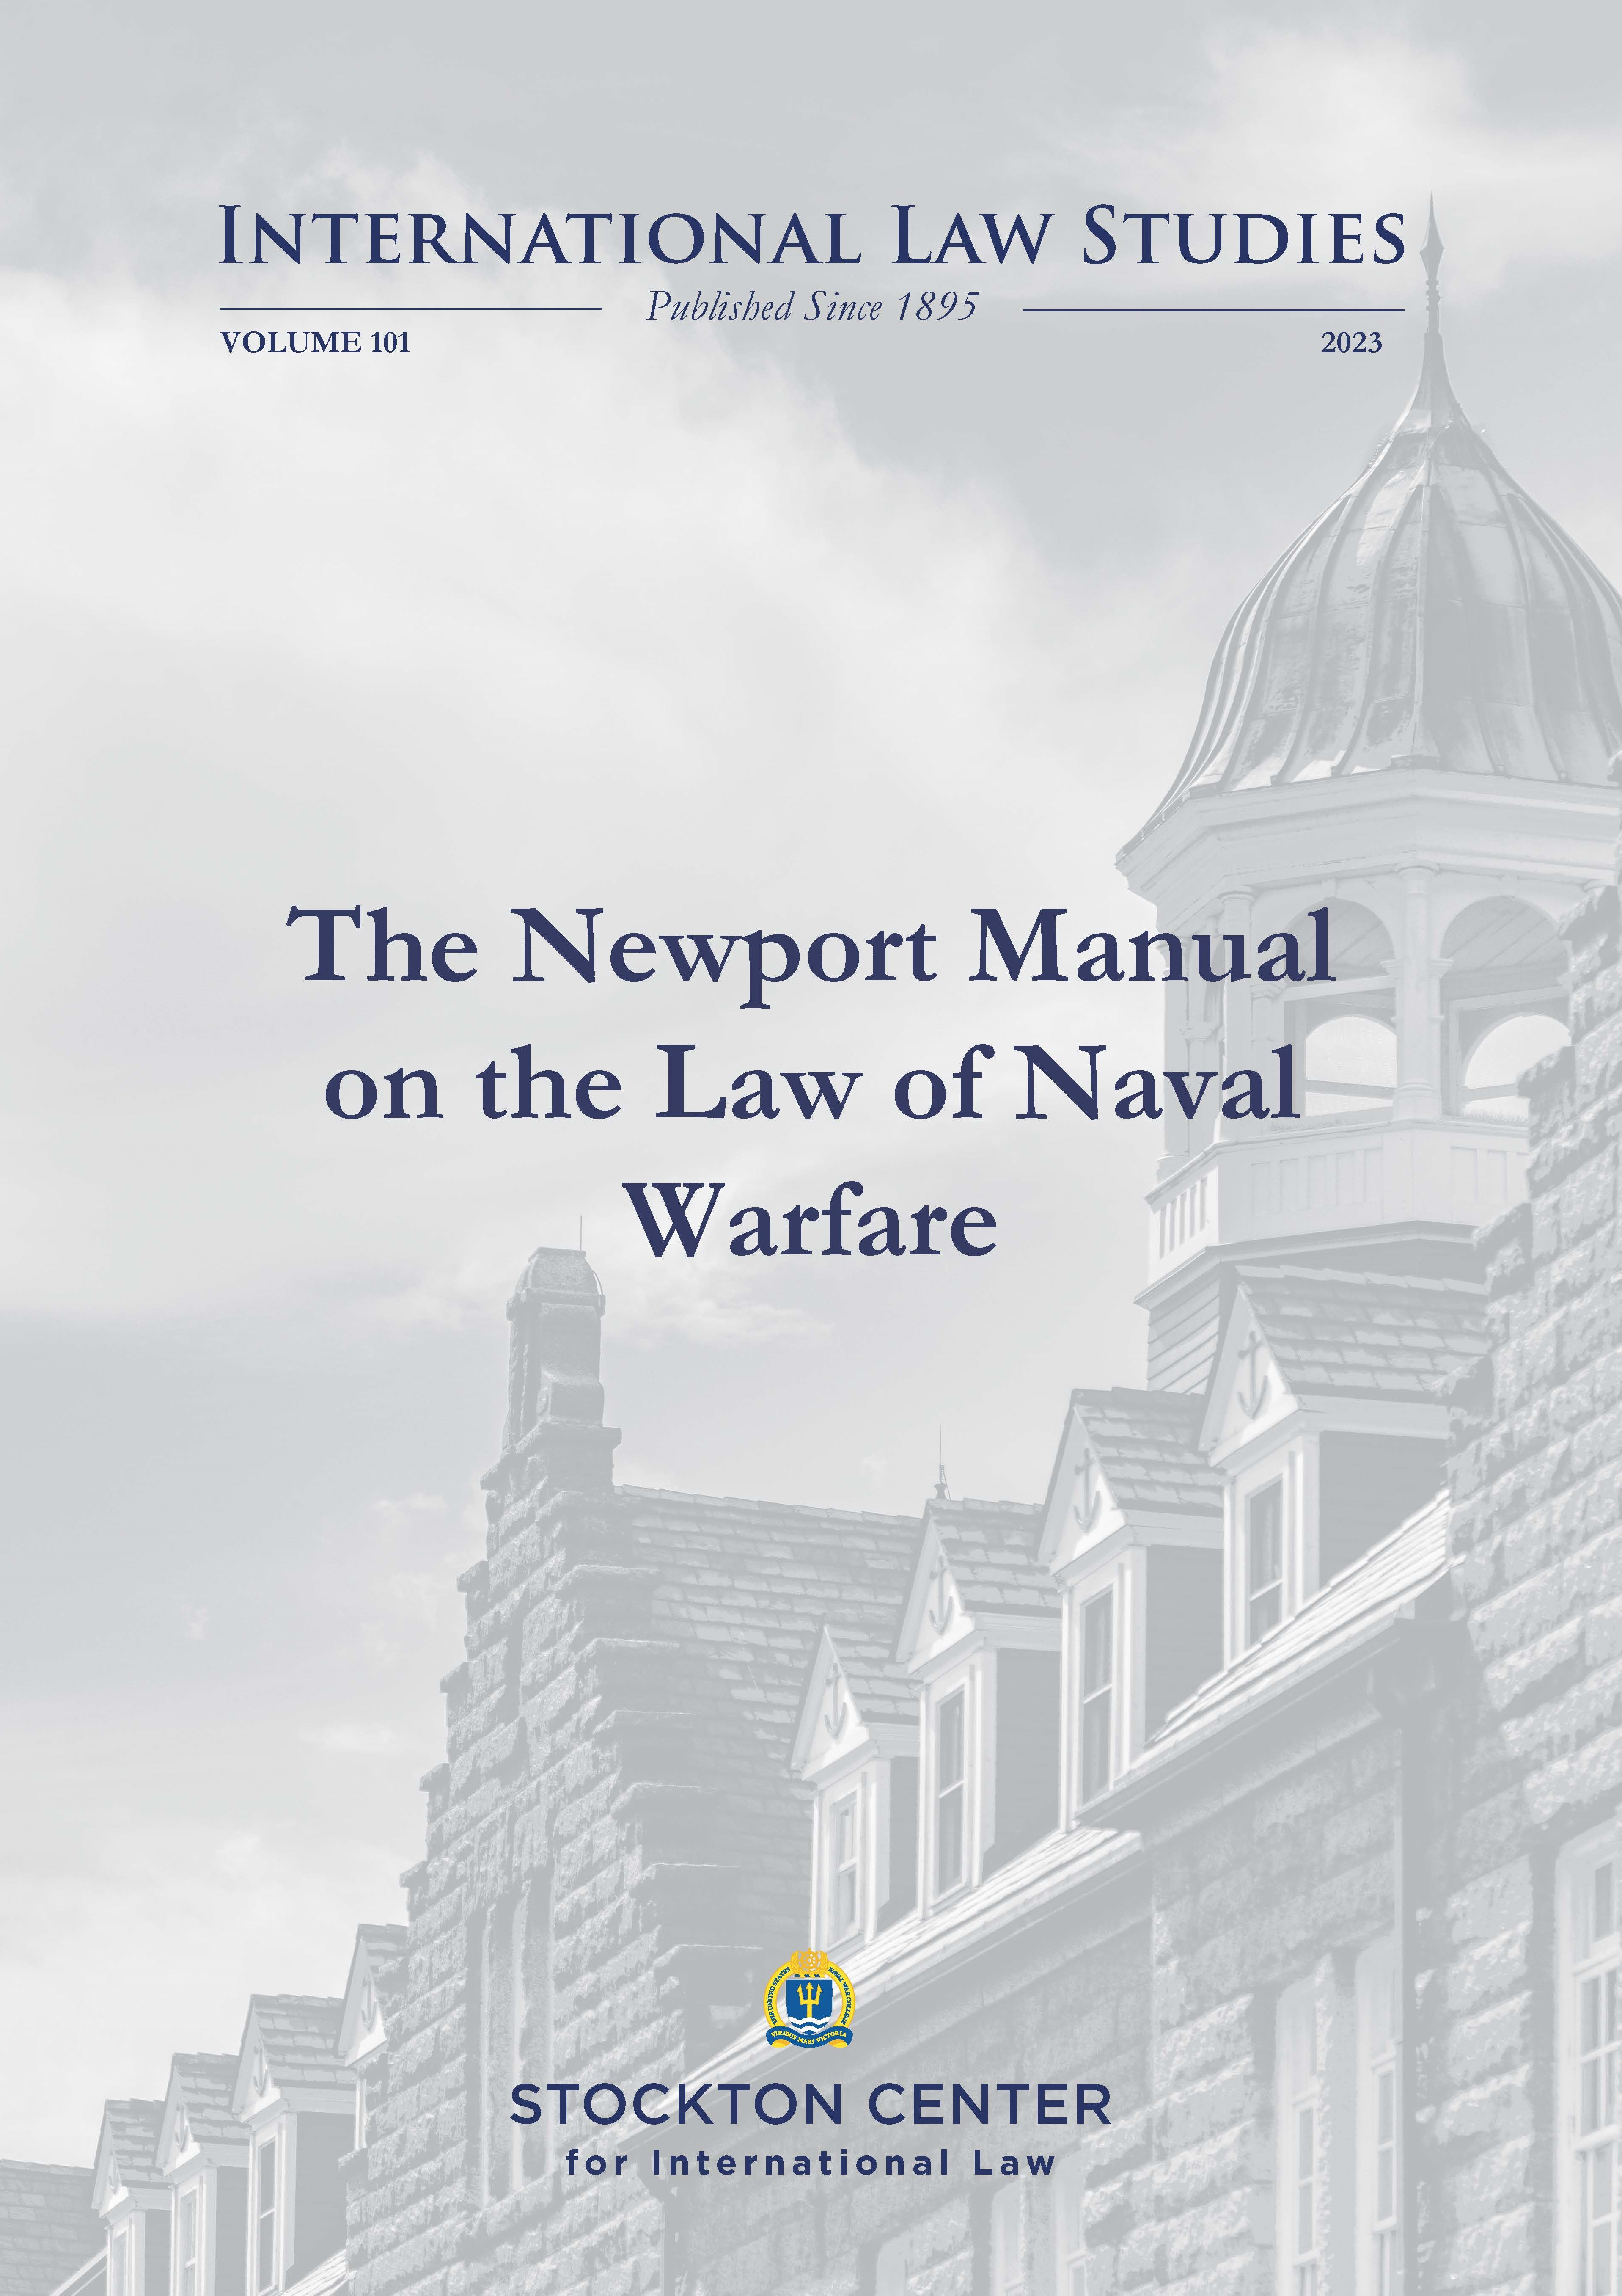
Why we wrote it
Increased likelihood of naval conflict
Support maritime coalition operations in armed conflict
Changes in technology—systems and weapons
Lack of contemporary manual on state practice (lex lata)
The Newport Manual on the Law of Naval Warfare,
101 International Law Studies (2023)
Notes:
Increased likelihood of naval conflict
Maritime coalition operations in armed conflict
Lack of contemporary manual on state practice
VOL 101 ILS (2023)

Slide 4
2023 Newport Manual
Work of Scholarship
Only addresses naval warfare
9 Experts from Maritime Powers (Australia, Germany, India, Japan, United States, United Kingdom)
Expert Peer Review (Australia, Denmark, Israel, Japan, Philippines, Switzerland, United Kingdom)

Slide 5
Newport Manual Authors
Captain James Farrant, Royal Navy Barrister Associate Professor David Letts (Commodore, Royal Australian Navy, Retired), Director of the Centre for Military and Security Law at The Australian National University College of Law Dr. Yurika Ishii, Associate Professor, National Defense Academy of Japan Rob McLaughlin (Commodore, Royal Australian Navy, Retired), Professor, Australian National Centre for Ocean Resources and Security (ANCORS), University of Wollongong Dr. James Kraska (Commander, U.S. Navy Retired), Charles H. Stockton Professor of International Maritime Law and Chairman, Stockton Center for International Law, U.S. Naval War College Raul “Pete” Pedrozo (Captain, U.S. Navy Retired), Howard S. Levie Professor on the Law of Armed Conflict, Stockton Center for International Law, U.S. Naval War College Captain (Dr.) Gurpreet S. Khurana, Indian Navy (Retired), Former Directing Staff and Professor, Naval War College, Goa Commander Koki Sato, Operational Law Office, Command & Staff College, Japan Maritime Self Defense Force Prof. Dr. Wolff Heintschel von Heinegg, Chair of Public Law, in particular Public International Law, European Law and Foreign Constitutional Law, Europa-Universität Viadrina
Notes:
9 authors: - Japan, Australia, US + India, UK, Germany
UK RN
2 Japanese (JMSDF and NDA)
2 Australians ANU and Wollongong
1 INS
1 German
2 US (NWC)
7 active or officers (2 Commodore, 3 Captains, 2 commanders)
7 professors
All personal capacity

Slide 6
Table of Contents
1 Concepts and Sources of the Law of Naval Warfare | 7 Methods of Naval Warfare
2 Scope of Application of the Law of Naval Warfare | 8 The Law of Targeting at and from the Sea
3 Status of Vessels, Aircraft, and their Crews | 9 Prize Law
4 Areas of Naval Operations | 10 Protected Vessels, Aircraft, and Persons at Sea
5 Basic Principles of the Law of Armed Conflict | 11 Maritime Neutrality
6 Means (Weapons) of Naval Warfare | 12 Non-International Armed Conflicts
Notes:
Style…not pedantic rules because states disagree;
Focus on functional areas

Slide 7
1.1 Distinct Nature 1.2 Sources of LONW 1.3 War Crimes at Sea 1.4 Responsibility
1 Concepts and Sources of the Law of Naval Warfare
Conduct of Hostilities
Maritime Neutrality
Prize Law
Law of the Sea
Notes:
law of naval warfare – like the law of air warfare – rests on 3 pillars:
(1) rules and principles governing the conduct of hostilities, including the legality of methods and means of naval warfare, and the protection of victims and civilians and civilian objects at sea;
(2) PRIZE:
- naval warfare (like air warfare, but unlike land warfare) is characterized by an element of economic warfare.
- belligerents at sea are permitted to capture enemy merchant vessels and civil aircraft, and enemy goods therein, outside neutral waters and airspace;
(3) NEUTRALITY: art. 17 of 2011 ILC Draft on Effect of Armed Conflict on Treaties – Law of neutrality duty and obligations not changed
- neutrality also applies in land warfare. -- prevent an escalation of an international armed conflict.
Hauge (V) Respecting the Rights and Duties of Neutral Powers and Persons in Case of War on Land, 1907
Hague XIII right of access to neutral ports
(4) LOS – indirect; excludes neutral waters; archipelagic waters, territorial sea (transit) and TP + ASLP

Slide 8
Newport Manual 1.2.2 AP I, art. 49(3) and arts. 48 – 67
Applicability of AP I
Land, air, sea warfare that affects the civilian population on land
+
attacks from the sea or from the air against objectives on land
Notes:
AP I

Slide 9
Newport Manual 1.2.2 AP I, art. 49(3) and arts. 48 – 67
Applicability of AP I
… apply to naval bombardment of land targets and to naval operations in the close proximity to the coastline that may inflict harm to protected persons and objects on land.
Notes:
AP I
Naval ops on land

Slide 10
Newport Manual 1.2.2 AP I, art. 49(3) and arts. 48 – 67
Articles 48 to 67 “do not otherwise affect the rules of international law applicable in armed conflict at sea or in the air.”
Does not apply to sea-to-sea; sea-to-air; air-to-sea; air-to-air
Notes:
What rule then applies? CIL
1.2.4 Customary International Law
CIL reflects extensive development of naval warfare law by state practice and accompanying opinio juris.
The question of how different rules apply to newly developed technologies and methods may present challenges, especially where there is limited state practice and accompanying opinio juris.
ICJ - criteria for recognition CIL - North Sea Continental Shelf (Germany/Netherlands and Germany/Denmark), ICJ Reports 1969, p. 3, para 74,
“State practice, including that of States whose interests are specially affected, should have been both extensive and virtually uniform”
“occurred in such a way as to show a general recognition that a rule of law or legal obligation is involved.”

Slide 11
2 Scope of Application of the LONW
2.1 International Armed Conflict (IAC)
2.2 Non-International Armed Conflict (NIAC)
very limited applicability
2.3 Law of Naval Warfare and Maritime Law Enforcement
not IAC; not state-on-state use of force
2.4 Law of Naval Warfare and the UN Charter
Self-defense and UNSC actions
jus in bello applies regardless of legitimacy of jus ad bellum
Notes:
§ 2.2.2 LNW applies to NIACs extending to the sea only insofar as the rules and principles
conduct of hostilities and
protection of civilians, civilian objects, and victims at sea
2.4 Law of Naval Warfare and the UN Charter
2.4.1 Self-Defense
2.4.1.1 National Self-Defense (Article 51 UN Charter)
2.4.1.2 Individual and Unit Self-Defense
2.4.2 UN Security Council Actions
2.4.3 Equal Application of the Jus in bello – regardless of violation of jus ad bellum or victim
HRW Study – Ukraine Violations

Slide 12
3 Status of Vessels, Aircraft, and their Crews
3.1 Belligerent Rights
3.2 Warships and Other Government Ships
3.3 Unmanned and Autonomous Maritime Systems
3.4 Naval Auxiliaries
3.5 Other Government Ships
3.6 Privateers
3.7 Maritime Militia
3.8 Crew of Warships and Naval Auxiliaries
3.9 Merchant Ships and Their Crews
3.10 Aircraft

Slide 13
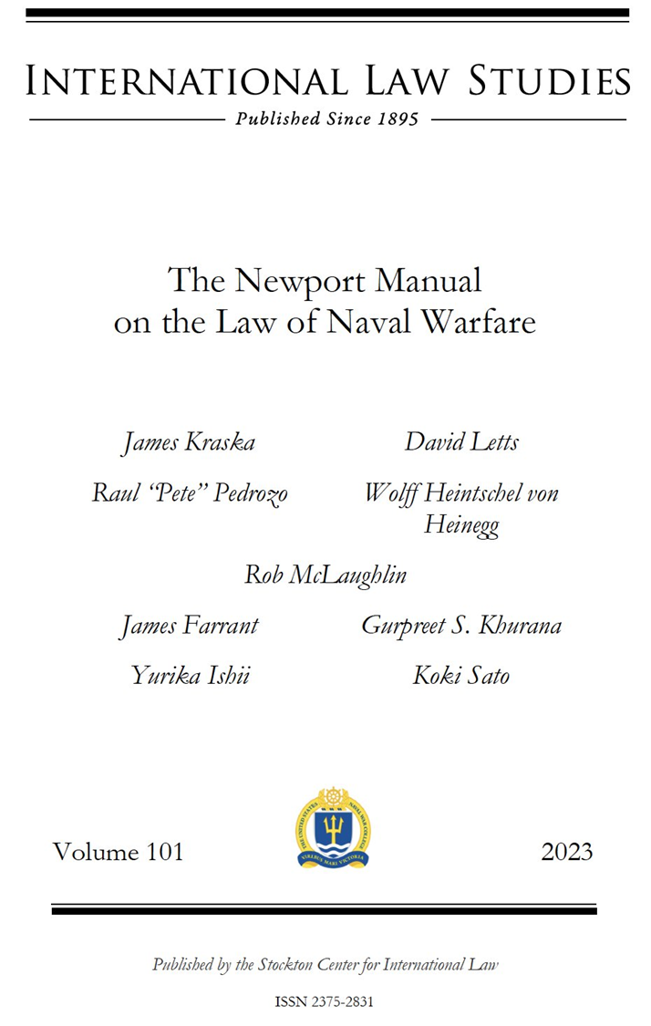
3.3 Unmanned Maritime Systems
UMV not referenced in other manuals
Newport Manual factors in current state practice in the development of new warfighting technologies in recent decades that have influenced the nature of war at sea
UMSs referenced in 8 sections and 7 footnotes

Slide 14
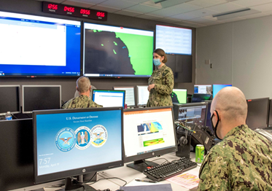
Newport Manual 3.2.1
Warships include both manned and unmanned surface ships, submarines, and other submersibles that have been designated as a warship by the flag State and are included in the respective State’s list/registry of warships.
There is no requirement that the commanding officer or crew be physically on board the warship.
Shore-based Command Center Port Hueneme, CA

Slide 15
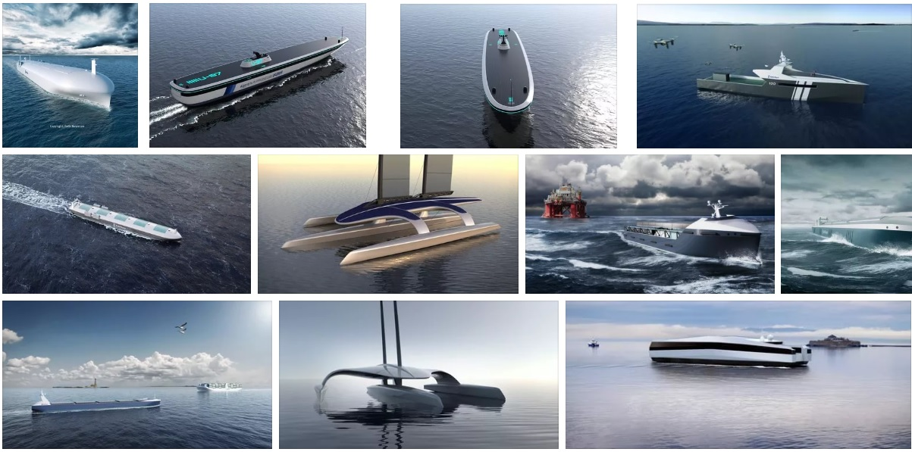
State Practice – Commercial Ships (IMO)

Slide 16
IMO MSC 107 (2022)
There should be a human master responsible for MASS regardless of mode of operation or degree or level of autonomy
Master need not be on board, depending on the technology used and human presence on board (if any)
Regardless of the mode of operation or degree or level of autonomy, the master should have a means to intervene when necessary
Remote Operation Centre – location remote from the MASS that can operate some or all aspects of the functions of the MASS
Remote Operator – a qualified person who is employed or engaged to operate some or all aspects of the functions of a MASS from a remote operation centre

Slide 17
State Practice—Military Vessels US Navy UUV (2004) // USV (2007) Master Plans

Slide 18
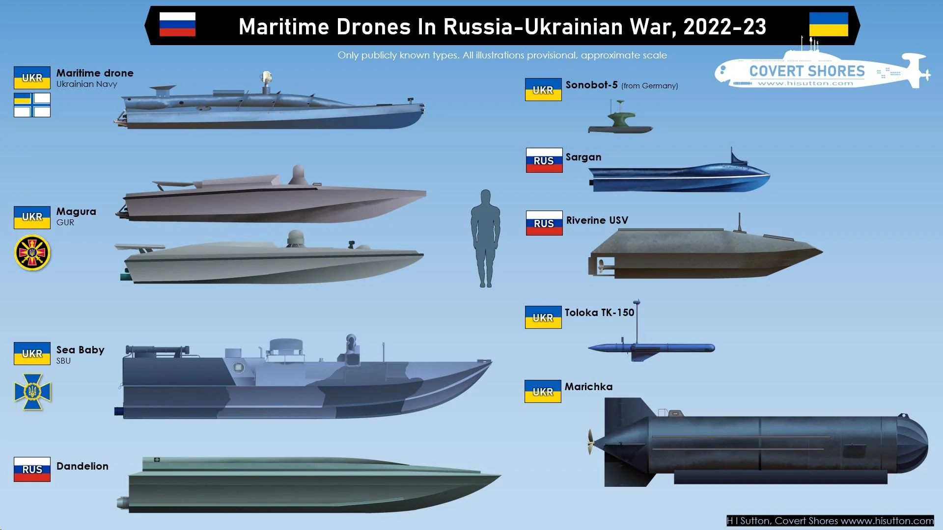

Slide 19
States developing UUVs/USVs

Slide 20
Iranian UUV

Slide 21
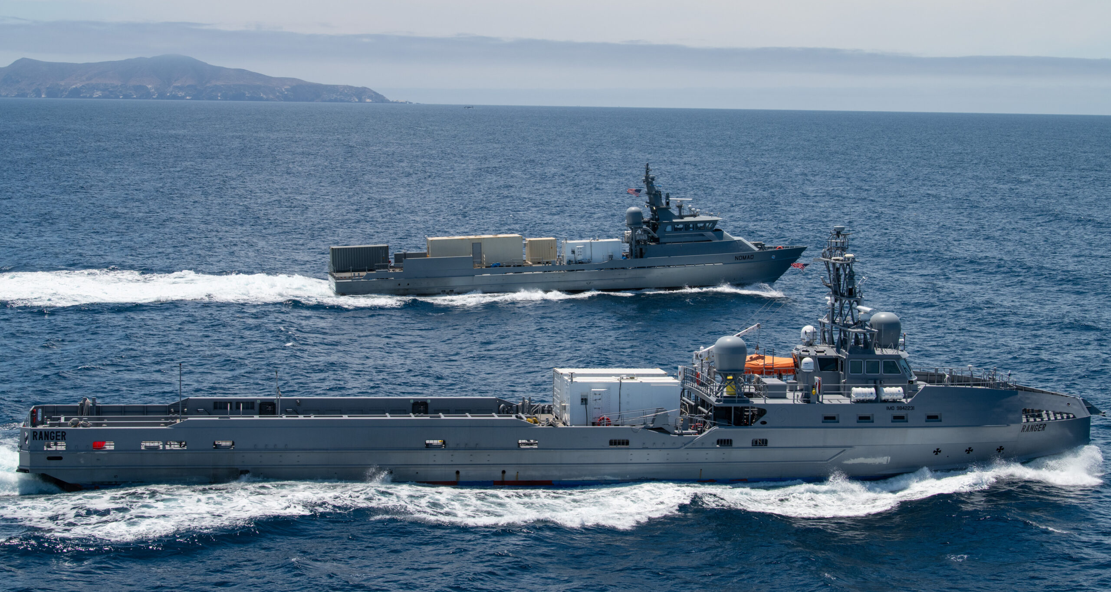
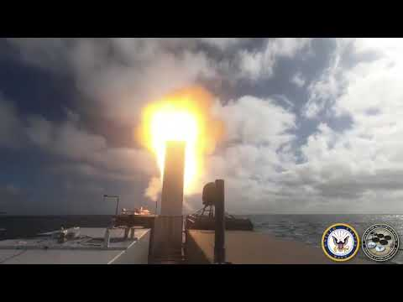
Unmanned Surface Vessels
SM-6 Missile Launch
Nomad
Ranger
Nomad
Ranger
Missile
Launcher

Slide 22
Unmanned Underwater Vehicles
ORCA

Slide 23
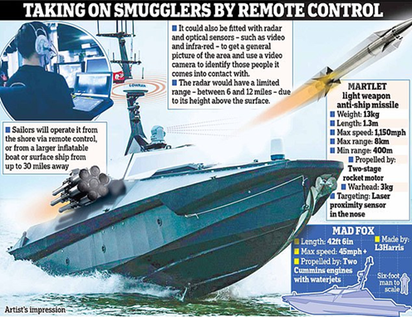
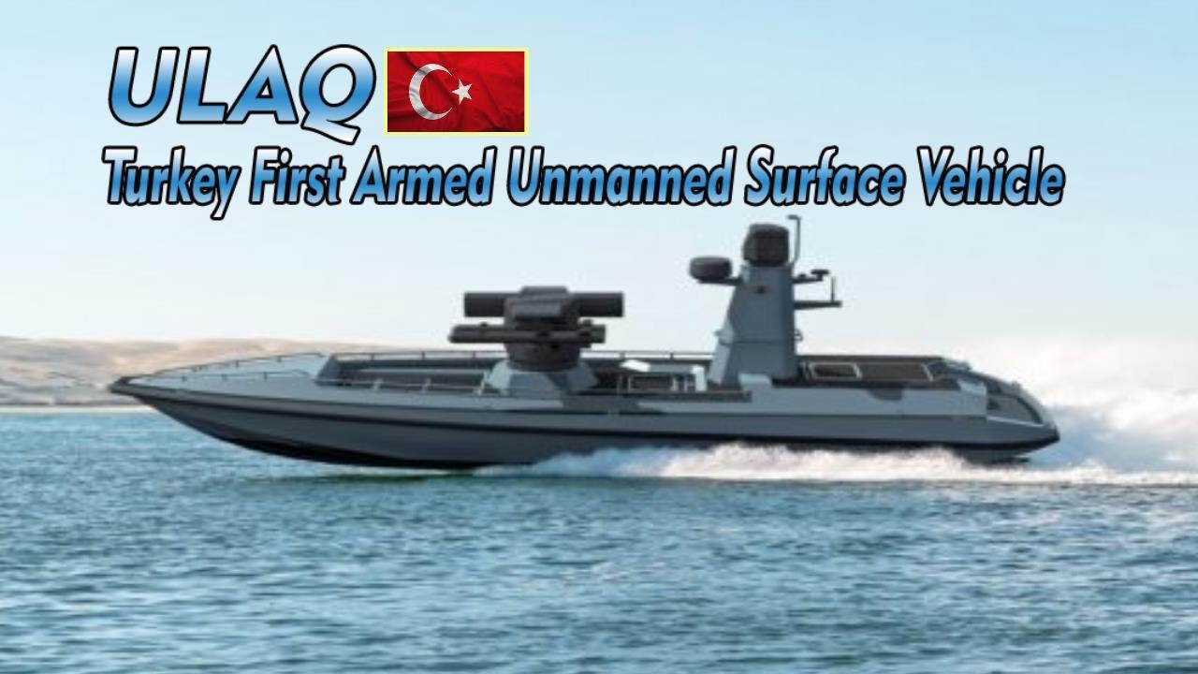
UK MADFOX Turkish Armed USV

Slide 24
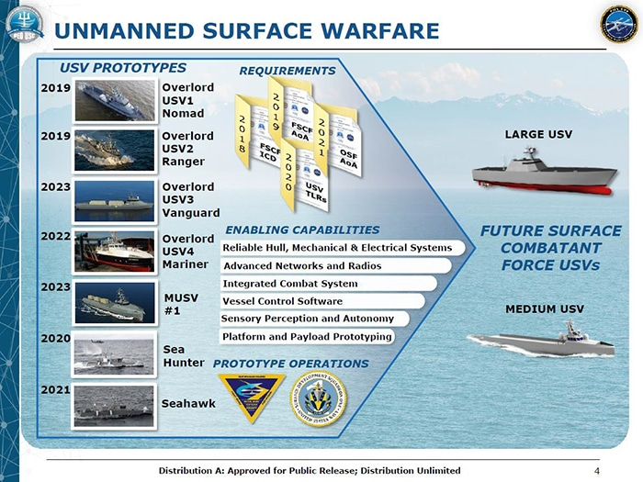
US—USV/UUV Delivered to the Fleet
Large USV Overload Program (Nomad, Ranger, Vanguard, Mariner)
Medium USV Program (Sea Hunter, Seahawk)
XLUUV (ORCA)
50K+ nm – autonomous mode almost all the time – minimal human intervention – COLREG compliant
Notes:
Ranger, Mariner, Sea Hunter, Seahawk deployed to Western Pacific
USVs sailed a combined 46,000 nautical miles
Stayed in autonomous mode almost all of the time
Human crews intervened when needed, about once every 2 weeks
Autonomy suite deactivated only 13 times for all four USVs during that time period

Slide 25
SECNAVINST 5030.8D (2022)
GENERAL GUIDANCE FOR THE CLASSIFICATION OF NAVAL VESSELS AND BATTLE FORCE SHIP COUNTING PROCEDURES
Encl. (4) – Unmanned Maritime Platform Category
Unmanned platforms are not currently counted in the battle force or maintained in the NVR
Certain unmanned maritime vehicles may, in the future, be part of the battle force inventory
Testing of these platforms and their concepts of employment continue to evolve
When these platforms are deemed capable of contributing to combat operations, the CNO will recommend their reclassification and inclusion in the battle force count for SECNAV approval.

Slide 26
UK Procedures
UK Royal Navy unmanned vessels (of which there are 23 at the time of writing) are currently listed as auxiliaries in the experimentation section of the UK Defence Shipping Register, but with the aspiration that they be classified as warships where appropriate once the capabilities under experimentation are proven

Slide 27
Fifth Fleet IMX/CE 22

Slide 28
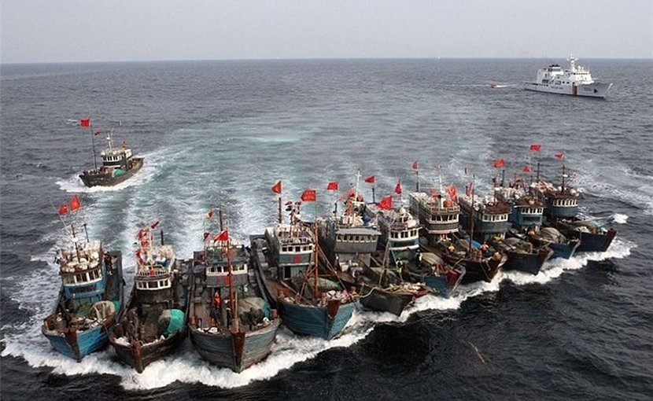
3.7 Maritime Militia State-owned v. commercial fishing vessels
Notes:
Flag State responsibility art. 94
Targetable if involved in the conflict (ISR)
Members of these militias or volunteer corps, whether integrated into the regular armed forces or not
Enjoy POW status or do not meet one of these conditions will be enemy merchant vessel crew (who are also entitled to POW status
or to the more favorable treatment available under the 1907 Hague (XI) Articles 5-8, provided the ship did not take part in hostilities
GC III, art. 4A(5);
China’s maritime militia—the People’s Armed Forces Maritime Militia (PAFMM)
World’s largest and most sophisticated maritime militia.
provide paramilitary support to the China Coast Guard (CCG), (PLAN) in times of peace and war

Slide 29
4 Areas of Naval Operations
4.1 Legal Divisions of the Sea
4.2 Special Areas (Southern Ocean; NWFZs)
4.3 Legal Divisions of the Airspace
Notes:
§ 2.2.2 LNW applies to NIACs extending to the sea only insofar as the rules and principles
conduct of hostilities and
protection of civilians, civilian objects, and victims at sea
2.4 Law of Naval Warfare and the UN Charter
2.4.1 Self-Defense
2.4.1.1 National Self-Defense (Article 51 UN Charter)
2.4.1.2 Individual and Unit Self-Defense
2.4.2 UN Security Council Actions
2.4.3 Equal Application of the Jus in bello – regardless of violation of jus ad bellum or victim
HRW Study – Ukraine Violations

Slide 30
5 Basic Principles of the Law of Armed Conflict
5.1 Introduction
5.2 Humanity
5.3 Military Necessity
5.4 Distinction
5.5 Additional Basic Rules
5.5.1 Proportionality
5.5.2 Unnecessary Suffering & Superfluous Suffering
5.5.3 Chivalry/Honor
Notes:
§ 2.2.2 LNW applies to NIACs extending to the sea only insofar as the rules and principles
conduct of hostilities and
protection of civilians, civilian objects, and victims at sea
2.4 Law of Naval Warfare and the UN Charter
2.4.1 Self-Defense
2.4.1.1 National Self-Defense (Article 51 UN Charter)
2.4.1.2 Individual and Unit Self-Defense
2.4.2 UN Security Council Actions
2.4.3 Equal Application of the Jus in bello – regardless of violation of jus ad bellum or victim
HRW Study – Ukraine Violations

Slide 31
6 Means (Weapons) of Naval Warfare
6.1 Definition of Means of Naval Warfare
6.2 Requirements under Weapons Law
6.3 Environment
6.4 Naval Guns
6.5 Mines
6.6 Torpedoes
6.7 Missiles and Rockets
6.8 Directed Energy
6.9 Incendiary Weapons
6.10 Nuclear Weapons
Notes:
§ 2.2.2 LNW applies to NIACs extending to the sea only insofar as the rules and principles
conduct of hostilities and
protection of civilians, civilian objects, and victims at sea
2.4 Law of Naval Warfare and the UN Charter
2.4.1 Self-Defense
2.4.1.1 National Self-Defense (Article 51 UN Charter)
2.4.1.2 Individual and Unit Self-Defense
2.4.2 UN Security Council Actions
2.4.3 Equal Application of the Jus in bello – regardless of violation of jus ad bellum or victim
HRW Study – Ukraine Violations

Slide 32
6.3 Environment
AP I , art. 35(3) – “It is prohibited to employ methods or means of warfare which are intended, or may be expected, to cause widespread, long-term and severe damage to the natural environment.”
What is “long-term”?—ICRC Commentary—measured in decades
Does not reflect customary international law
SRM – lex ferenda –not reflective of customary international law
Rule 11: “The Parties to the conflict are encouraged to agree that no hostile actions will be conducted in marine areas containing: (a) rare or fragile ecosystems; or (b) the habitat of depleted, threatened or endangered species or other forms of marine life.”
Rule 44: “[m]ethods and means of warfare should be employed with due regard for the natural environment” and “[d]amage to or destruction of the natural environment not justified by military necessity and carried out wantonly is prohibited.”
Notes:
SAN REMO MANUAL ¶ 11: “The Parties to the conflict are encouraged to agree that no hostile actions will be conducted in marine areas containing: (a) rare or fragile ecosystems; or (b) the habitat of depleted, threatened or endangered species or other forms of marine life.” At paragraph 44, the Manual suggests that “[m]ethods and means of warfare should be employed with due regard for the natural environment” and that “[d]amage to or destruction of the natural environment not justified by military necessity and carried out wantonly is prohibited.”

Slide 33
6.3.1 Environmental Modification ENMOD Convention
Art. I—prohibits States parties from engaging “in military or any other hostile use of environmental modification techniques having widespread, long-lasting or severe effects as the means of destruction, damage or injury to any other State Party.”
Art. II—“environmental modification techniques” is defined as “any technique for changing—through the deliberate manipulation of natural processes—the dynamics, composition or structure of the earth, including its biota, lithosphere, hydrosphere and atmosphere.”
Prohibits using modification techniques that result in the environment itself being characterized as a weapon, rather than prohibiting certain military activities that cause damage to the environment.
Notes:
The ENMOD Convention prohibits States parties from engaging “in military or any other hostile use of environmental modification techniques having widespread, long-lasting or severe effects as the means of destruction, damage or injury to any other State Party.”421 The term “environmental modification techniques” is defined as “any technique for changing—through the deliberate manipulation of natural processes—the dynamics, composition or structure of the earth, including its biota, lithosphere, hydrosphere and atmosphere.”422 The prohibition is therefore on using modification techniques that result in the environment itself being characterized as a weapon, rather than prohibiting certain military activities that cause damage to the environment. Russia’s Poseidon underwater drone may be an example of a weapon that might produce an unlawful modification to the natural environment. The weapon is armed with a two-megaton nuclear warhead that when detonated at the coastline is designed to create a tsunami powerful enough to destroy enemy port cities and naval bases.423 The unleashing of environmental forces is incompatible with the law of war.424 Unlike a weapon designed to destroy enemy forces, the Poseidon uses the natural environment as an intervening cause of destruction and erases the distinction between the enemy’s armed forces and the civilian population.425

Slide 34
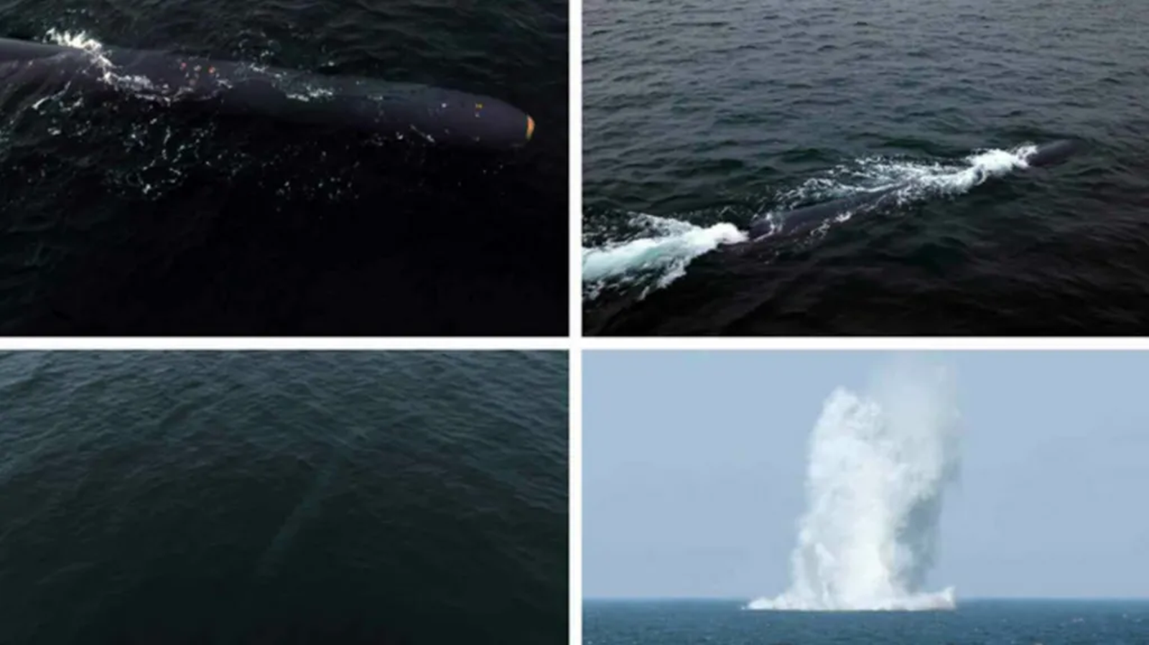
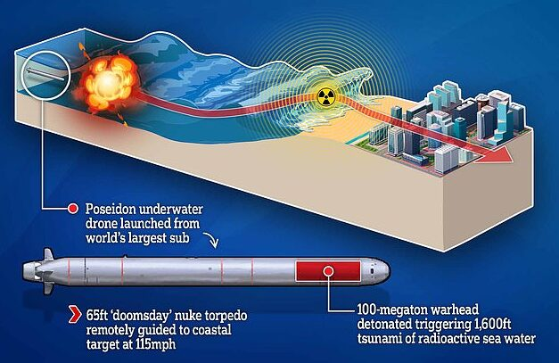
Nuclear-Armed Autonomous Drones DPRK Haeil-5-23 RF Poseidon
Notes:
Russia’s Poseidon underwater drone may be an example of a weapon that might produce an unlawful modification to the natural environment. The weapon is armed with a two-megaton nuclear warhead that when detonated at the coastline is designed to create a tsunami powerful enough to destroy enemy port cities and naval bases.423 The unleashing of environmental forces is incompatible with the law of war.424 Unlike a weapon designed to destroy enemy forces, the Poseidon uses the natural environment as an intervening cause of destruction and erases the distinction between the enemy’s armed forces and the civilian population.425

Slide 35
7 Methods of Naval Warfare
7.1 Methods of Naval Warfare Defined
7.2 Sea Control and Sea Denial
7.3 Counter-Sea Control and Counter-Sea Denial Operations
7.4 Blockade
7.5 Deception, Intelligence Gathering, and Espionage Operations
Notes:
§ 2.2.2 LNW applies to NIACs extending to the sea only insofar as the rules and principles
conduct of hostilities and
protection of civilians, civilian objects, and victims at sea
2.4 Law of Naval Warfare and the UN Charter
2.4.1 Self-Defense
2.4.1.1 National Self-Defense (Article 51 UN Charter)
2.4.1.2 Individual and Unit Self-Defense
2.4.2 UN Security Council Actions
2.4.3 Equal Application of the Jus in bello – regardless of violation of jus ad bellum or victim
HRW Study – Ukraine Violations

Slide 36
7.4 Blockade
7.4.2 Notification
7.4.3 Effectiveness
7.4.4 Impartiality
7.4.5 Humanitarian Requirements
7.4.6 Access to Neutral Coast
7.4.7 Breach and Attempted Breach of Blockade

Slide 37
7.4.5 Humanitarian Requirements
Prohibited if solely intended to starve the civilian population, or solely intended to deprive the civilian population of objects essential to its survival
Rule 102(b)—applies the prohibition of excessive collateral damage to blockade, although a blockade does not qualify as an attack
Not reflective of international law
Impartiality—no exemption from blockade enforcement for vessels carrying humanitarian materials intended for the civilian population unless otherwise authorized by the belligerents
Notes:
The establishment of a blockade is prohibited if it is solely or primarily intended to starve the civilian population, or solely or primarily intended to deprive the civilian population of objects essential to its survival.483 However, there is no rule that a blockade is unlawful if it has an effect on the civilian population that is disproportionate to the military advantage gained from the blockade.484 There is no exemption from blockade enforcement for vessels carrying humanitarian materials intended for the civilian population of a blockaded area. However, the blockading State may make and declare arrangements for the provision of humanitarian support to a blockaded area, whether by sea or by land.
Rule 102(b) of the San Remo Manual applies the prohibition of excessive collateral damage to blockade, although a blockade does not qualify as an attack as defined in Chapter 8. The assertion in the San Remo Manual is without evidence of State practice or opinio juris in support of it and therefore not reflective of international law.

Slide 38
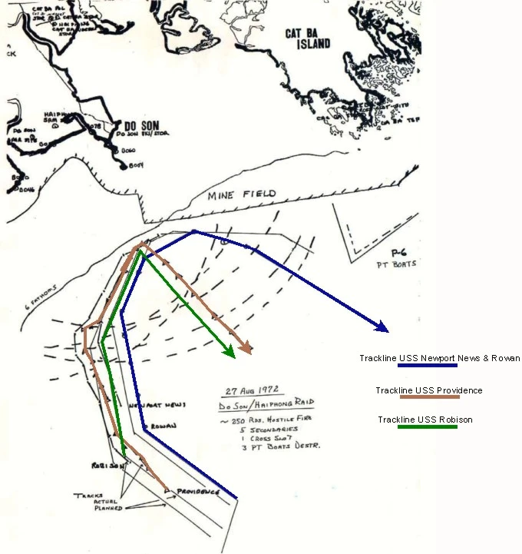
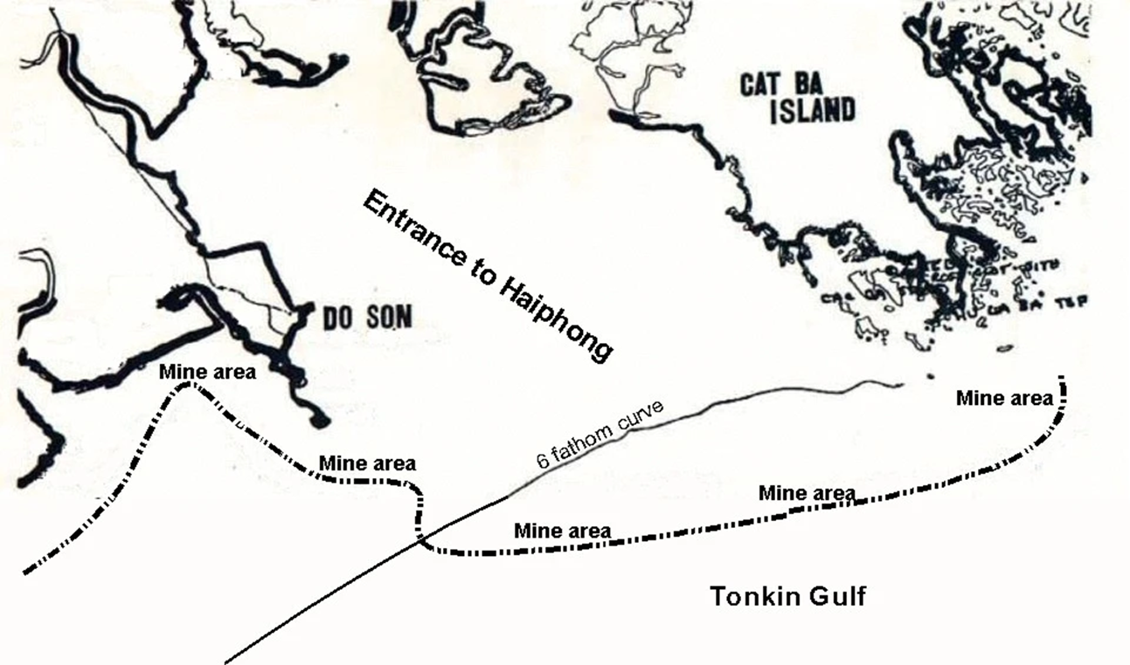
Operation Pocket Money (1972) Mining/Blockade NVN Surface Vessels Notification (radio, TV, UNSC, DIPNOTES, NOTMARs)
3-days delayed activation
Notes:
“The mining was announced by President Nixon on radio and television on the evening of 8 May 1972. Appropriate notification was also given to all other nations concerned, both by a letter to the President of the United Nations Security Council, and by direct bilateral diplomatic notification, as well as by notices to mariners. That same day (9 May 1972, in Hanoi), mines were dropped by aircraft in Haiphong harbor (and in Cam Pha and Hon Gai harbors), three days in advance of the mines becoming armed, thus permitting the ships in the harbor three periods of daylight in which to leave if they so desired.”

Slide 39
8 The Law of Targeting at and from the Sea
8.1 Applicability of Targeting Law and the Concept of Attack
8.2 Sources of Law on Targeting
8.3 Approach to Targeting Law
8.4 Distinction at Sea and on Land
8.5 Military Objectives at Sea and on Land
8.6 Targeting Military Objectives at Sea
8.7 Targeting Military Objectives on Land
8.8 Proportionality at Sea and on Land
8.9 Precautions in Attack
Notes:
§ 2.2.2 LNW applies to NIACs extending to the sea only insofar as the rules and principles
conduct of hostilities and
protection of civilians, civilian objects, and victims at sea
2.4 Law of Naval Warfare and the UN Charter
2.4.1 Self-Defense
2.4.1.1 National Self-Defense (Article 51 UN Charter)
2.4.1.2 Individual and Unit Self-Defense
2.4.2 UN Security Council Actions
2.4.3 Equal Application of the Jus in bello – regardless of violation of jus ad bellum or victim
HRW Study – Ukraine Violations

Slide 40
Newport Manual 8.5 AP I, art. 49(3) and arts. 48 – 67
Principle of Distinction, art. 48
Indiscriminate attacks, art. 51
Military objectives, art. 52(2)
Precautions in Attack, art. 57
SRM says API I reflects CIL, but….
Notes:
AP I
Naval ops on land or impact on civilian population
SRM – says these provisions reflect CIL = 39, 40, 42(b), 46
BUT – AP I definitions are not accepted by all states, e.g. military objectives 52(2)
US “effective contribution to military effort” + “war sustaining effort” qualify as lawful targets
Civil War – cotton fields
But Tanker War – both attacked oil tankers, but all states condemned violation of LOAC
57(4) = reasonable precautions to avoid loss” –
less strict than “feasible”, art. 57(2) (on land) (SRM tries to impose feasible on sea-to-sea)
57(4) "all reasonable precautions" must be taken, which is undoubtedly slightly different from and a little less far-reaching than the expression "take all feasible precautions", used in paragraph 2.

Slide 41
Military objectives, art. 52(2), AP I
Nature, location, purpose or use make an effective contribution to military action
and whose total or partial destruction, capture or neutralization
offers a definite military advantage

Slide 42
Military objectives, 10 USC § 950p
Nature, location, purpose or use to effectively contribute to the war-fighting or war-sustaining capability
and whose total or partial destruction, capture or neutralization
offers a definite military advantage

Slide 45
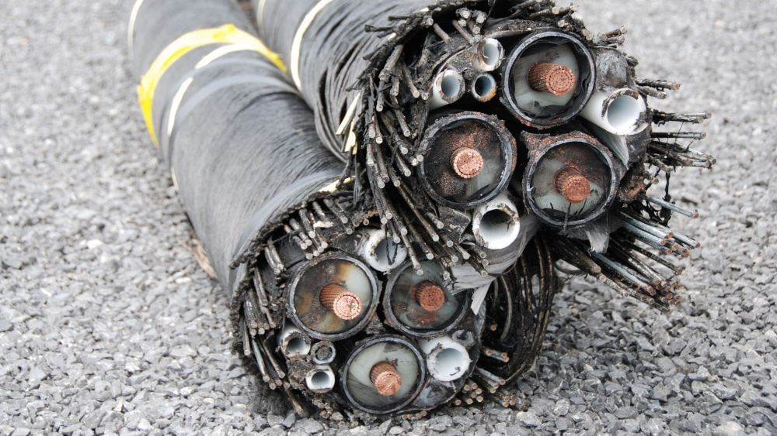
8.6.8 Submarine Cables and Pipelines
Military communications cables are military objects and may be targeted during armed conflict
Although civilian submarine cables are civilian objects, their common use by the armed forces means they may make an effective contribution to military action and their disruption or destruction may offer a definite military advantage
Notes:
8.6.8 Submarine Cables and Pipelines
Military communications cables are military objects
Most military communications cable traffic, however, travels through commercial submarine cables.
Military data through such cables is indistinguishable from ordinary commercial internet traffic. T
data packets travel through commercial submarine cables cannot be predicted or controlled by the cable owners.
civilian submarine cables are civilian objects, their common use by the armed forces means they may make an effective contribution to military action
and their disruption or destruction may offer a definite military advantage.
Destruction of a cable is an act of violence against the adversary that constitutes an attack,
distinguished from other interference, such as eavesdropping.
may destroy bilateral cables lying outside neutral territorial seas connecting the enemy and neutral states “if the necessities of war require.”
cables that are deemed to be military objectives -- application of the principles, such as military necessity, distinction, and the rule of proportionality
Economic or commercial losses resulting from the destruction of a submarine cable normally do not qualify as collateral damage.
8.6.8 Submarine Cables and Pipelines

Slide 46
8.8 Proportionality at Sea
AP I, art. 51(5)(b)—An attack is disproportionate—and therefore unlawful—if it “may be expected to cause incidental loss of civilian life, injury to civilians, damage to civilian objects, or a combination thereof, which would be excessive in relation to the concrete and direct military advantage anticipated.”
Not applicable at sea, but reflects customary international law
Applying the prohibition of excessive collateral damage at sea involves different factual considerations than on land
Risk of collateral damage to surrounding civilian objects is unlikely or much lower at sea than in a targeting action on land
Notes:
As with other AP I targeting rules, Article 51(5)(b) is not applicable at sea even for States party to AP I. Nonetheless, the rule reflects customary international law that attacks on land and at sea must not be disproportionate. 576 Applying the prohibition of excessive collateral damage at sea often involves different factual considerations than on land. In the case of targeting an enemy military objective at sea, the risk of collateral damage to surrounding civilian objects is unlikely or much lower than in a targeting action on land.

Slide 47
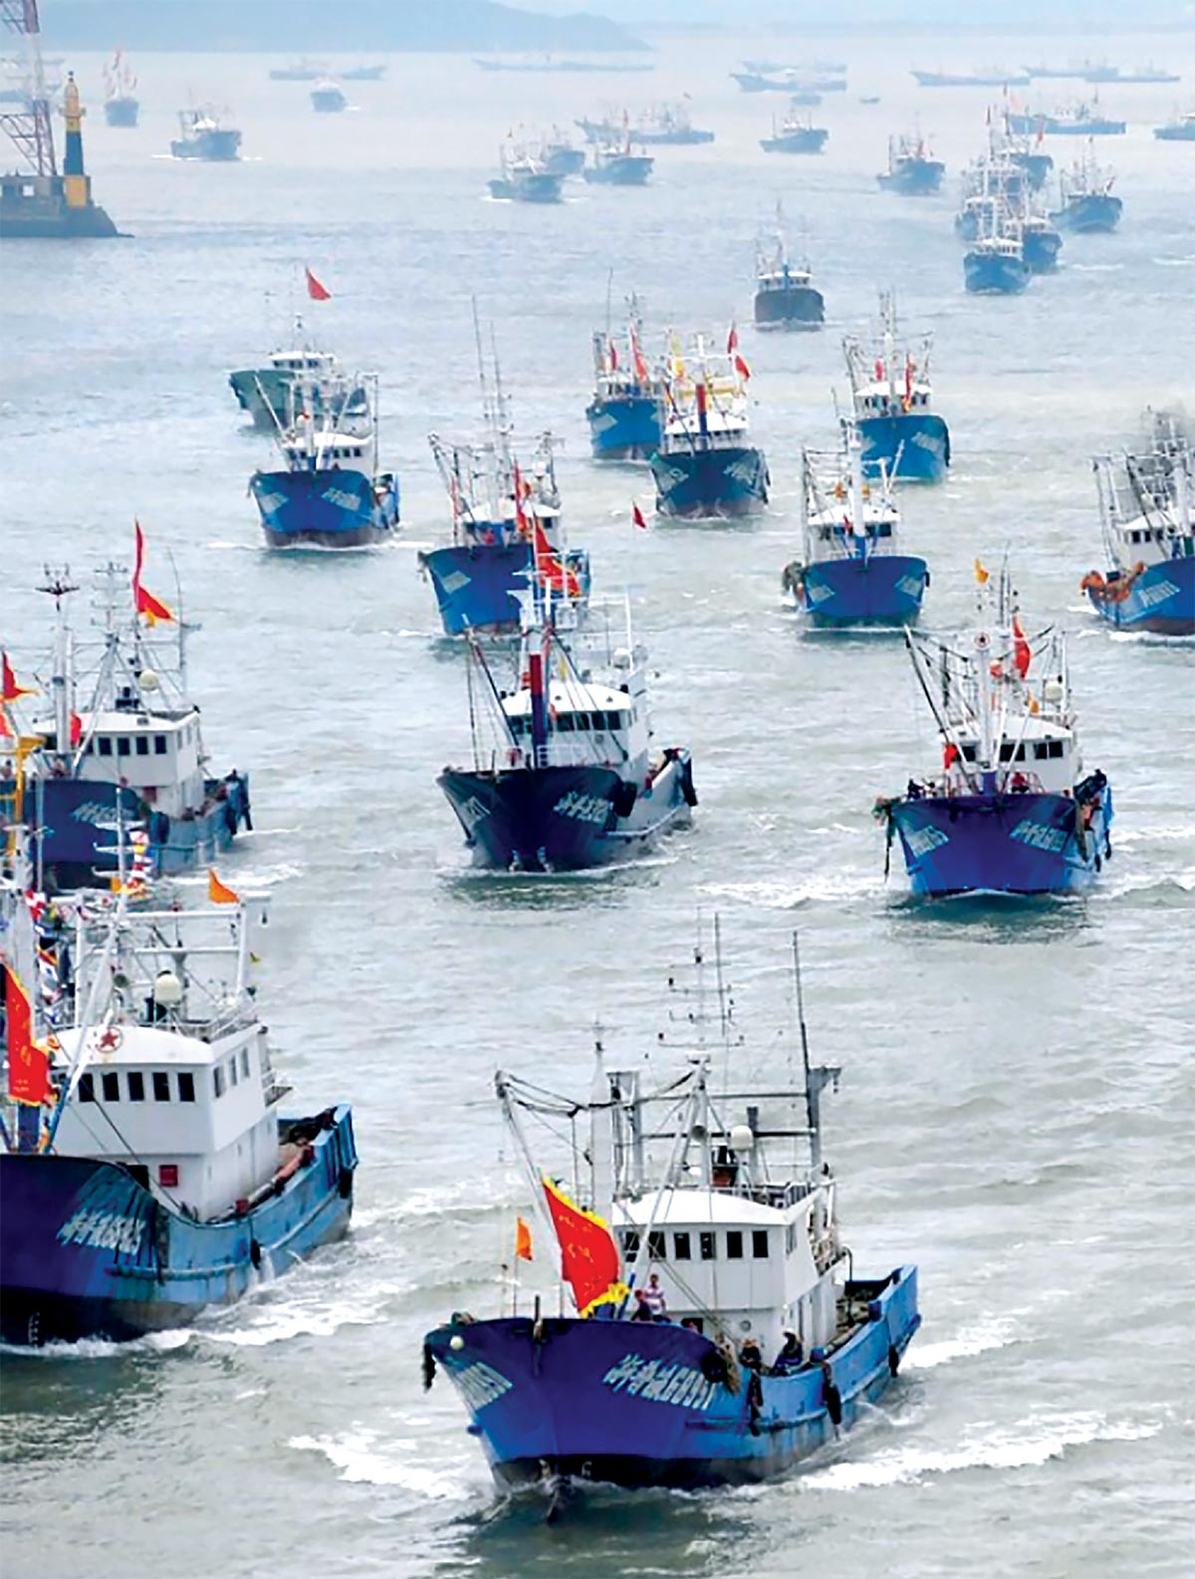
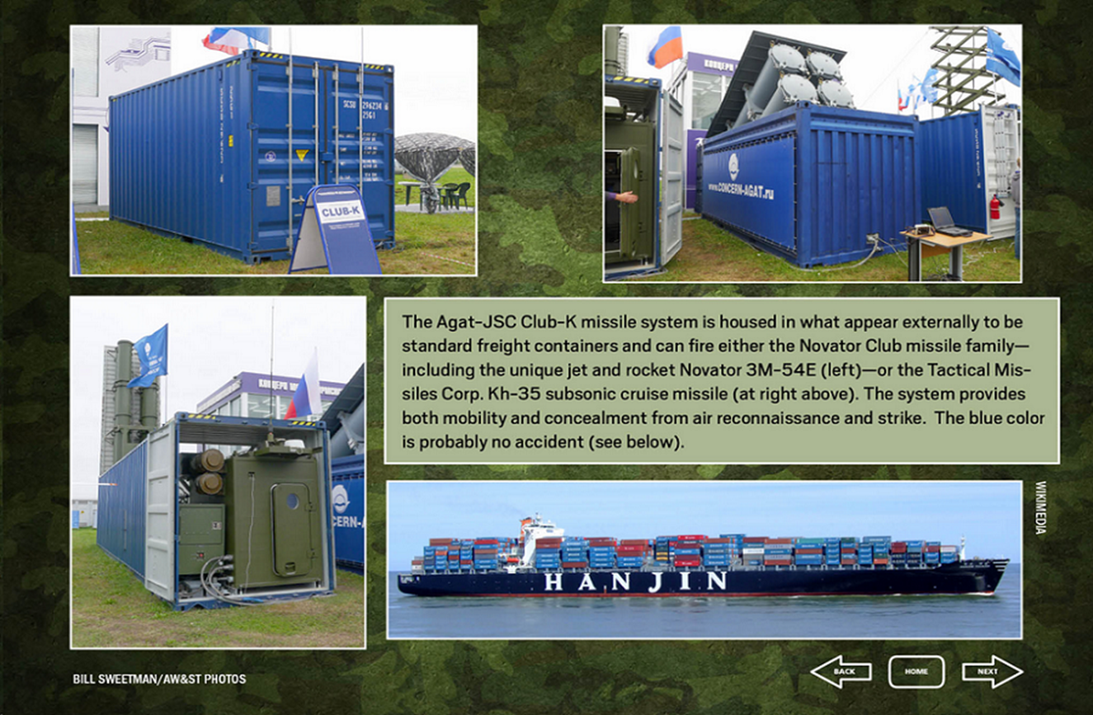
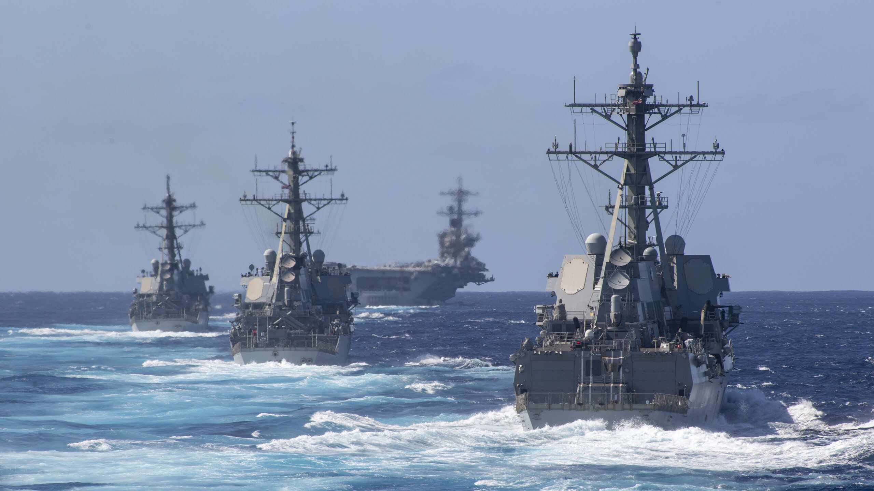
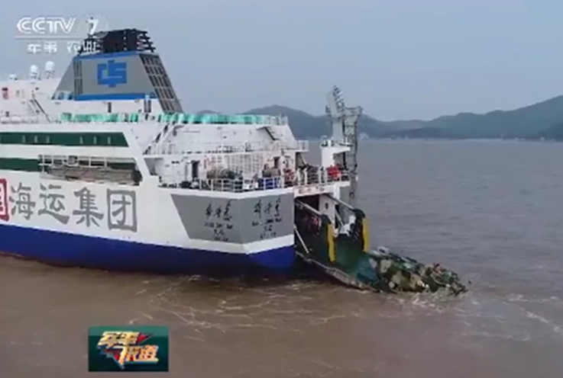
Platform-Based Targeting
Crews of targetable enemy platforms are not subject to a proportionality assessment even where some or all of them are civilians
Notes:
Under the law of naval warfare, the crews or ship’s companies of targetable enemy platforms (such as warships and auxiliaries) need not be subject to any proportionality assessment even where some or all of them are civilians.

Slide 48
Newport Manual 8.9 AP I, art. 49(3) and arts. 48 – 67
Principle of Distinction, art. 48
Indiscriminate attacks, art. 51
Military objectives, art. 52(2)
Precautions in Attack, art. 57
57(2) feasible precautions on land
57(4)reasonable precautions at sea
Notes:
UK Understanding (b) The United Kingdom understands the term "feasible" as used in the Protocol to mean that which is practicable or practically possible, taking into account all circumstances ruling at the time, including humanitarian and military considerations.
AP I
Naval ops on land or impact on civilian population
SRM – says these provisions reflect CIL = 39, 40, 42(b), 46
BUT – AP I definitions are not accepted by all states, e.g. military objectives 52(2)
US “effective contribution to military effort” + “war sustaining effort” qualify as lawful targets
Civil War – cotton fields
But Tanker War – both attacked oil tankers, but all states condemned violation of LOAC

Slide 49
Precautions in Attack, art. 57
Those who plan or decide upon an attack shall:
do everything feasible to verify that the objectives to be attacked are military objectives, art. 57(2)
In the conduct of military operations at sea or in the air … take all reasonable precautions to avoid losses of civilian lives and objects, art. 57(4)
SRM r. 46
NM 8.9.2
Notes:
57(4) = reasonable precautions to avoid loss” –
less strict than “feasible”, art. 57(2) (on land) (SRM tries to impose feasible on sea-to-sea)
57(4) "all reasonable precautions" must be taken, which is undoubtedly slightly different from and a little less far-reaching than the expression "take all feasible precautions", used in paragraph 2.

Slide 50
9 Prize Law
9.1 Prize Defined
9.2 Distinguishing Prize from Booty
9.3 Determining the Character of the Vessel
9.4 Enemy Merchant Vessels and Civil Aircraft Subject to Capture
9.5 Enemy Merchant Vessels and Civil Aircraft Exempt from Capture
9.6 Neutral Merchant Vessels and Civil Aircraft Subject to Capture
9.7 Neutral Merchant Vessels and Civil Aircraft Exempt from Capture
9.8 Neutral Warships, Other State Vessels, and State Aircraft

Slide 51
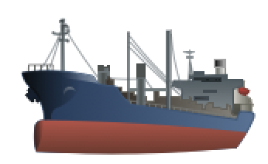
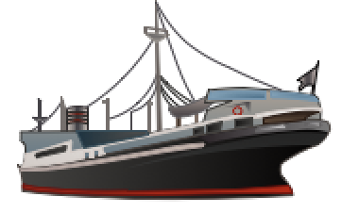
The Paris Declaration Respecting Maritime Law (1856) protected neutral rights.
Abolish privateers
Neutral flag covers enemy's goods
- Except contraband
Neutral goods under enemy flag protected from capture
No “paper blockades”
Newport Manual 9.6
Neutral Ship, Enemy goods
Enemy Ship, Neutral goods
Notes:
The Paris Declaration Respecting Maritime Law (1856) protected neutral rights.
Congress of Paris following the Crimean War (1853–6)
1st treaty uniting Europe, the Ottoman Empire and South America – same document law of nations became truly international.
Abolish privateers – close ports (confederate ships); shift from sail to steam – US would not join
UK – tie US hands – build norm; privateers were USN source
Neutral ships cover enemy goods
Neutral goods on enemy flag protected too
HOW DO YOU KNOW – VISIT AND SEARCH
By 1894 only Spain, Mex, US holdout, + Venezuela, Bolivia and Uruguay;
US would have joined during Civil War, but
Civil War: US said foreign powers must not, recognize the belligerency of the South, yet had already recognized Southern belligerency by refusing to punish the crews of Southern men of war as pirates despite Prize Causes, 2 Black, 635) and blockade of Southern ports, which is a war measure.
Holland, France and Spain as well as great Britain had already made formal recognition of the belligerency of the Confederate States.

Slide 52
9 Prize Law
9.9 The Belligerent Right of Visit and Search
9.10 Diversion
9.11 Active Resistance
9.12 Capture as Prize
9.13 Destruction of Prizes After Capture
9.14 Prize Courts and Adjudication
9.15 Crews and Passengers of Merchant Vessels
9.16 Unmanned Merchant Vessels

Slide 53
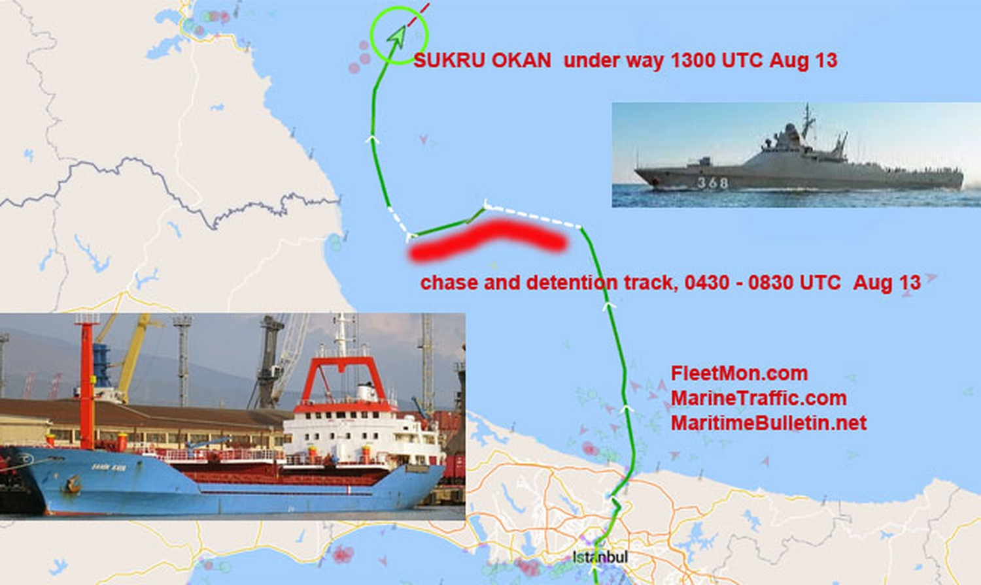
Palau-flagged cargo ship enroute Izmail
Boarding condemned by Ukraine
gross violation of UNCLOS and other norms of international law
Endangered FON and safety of commercial shipping in the Black Sea
Russia should not be able to block international routes in the Black Sea, particularly those leading to Ukrainian seaports
Example of conflating jus ad bellum and jus in bello

Slide 54
By-the-Book Visit and Search
Vasily Bykov hailed the Sukru Okan and demanded that it stop for inspection to determine if it was carrying contraband
The master of the Sukru Okan failed to respond to the order to stop
Vasily Bykov fired warning shots to force the vessel to heave to
Once the Sukru Okan stopped, it was boarded by Russian naval personnel
Boarding party searched the vessel and inspected the ship’s documents and passports of the Turkish crew
Boarding party determined that the vessel was not carrying contraband
Sukru Okan was allowed to continue its voyage
Boarding team did not threaten or take adverse actions against the crew

Slide 55
10 Protected Vessels, Aircraft, and Persons at Sea
10.1 The Second Geneva Convention
10.2 Other International Treaties
10.3 Applicability of Other Treaties During IAC
10.4 Specially Protected Vessels
10.5 Medical Aircraft
10.6 Protected Persons
10.7 Other People in Distress at Sea

Slide 56
10.4 Specially Protected Vessels
SRM, Rule 47—”The following classes of enemy vessels are exempt from attack: (e) passenger vessels when engaged only in carrying civilian passengers.”
Newport Manual 10.4—”Passenger liners qualify as merchant vessels …. If they have enemy character, they are liable to capture irrespective of the presence of civilian passengers on board.”
Notes:
Passenger liners qualify as merchant vessels as defined in Chapter 3. If they have enemy character, they are liable to capture irrespective of the presence of civilian passengers on board. The only legally relevant issue that may arise relates to a passenger liner qualifying as a lawful military objective by use. While it would then be liable to attack, some States are of the view that the civilian passengers on board specially protected vessels must be included in the collateral damage assessment.683 The classification of these passengers depends on the circumstances of the situation.

Slide 57
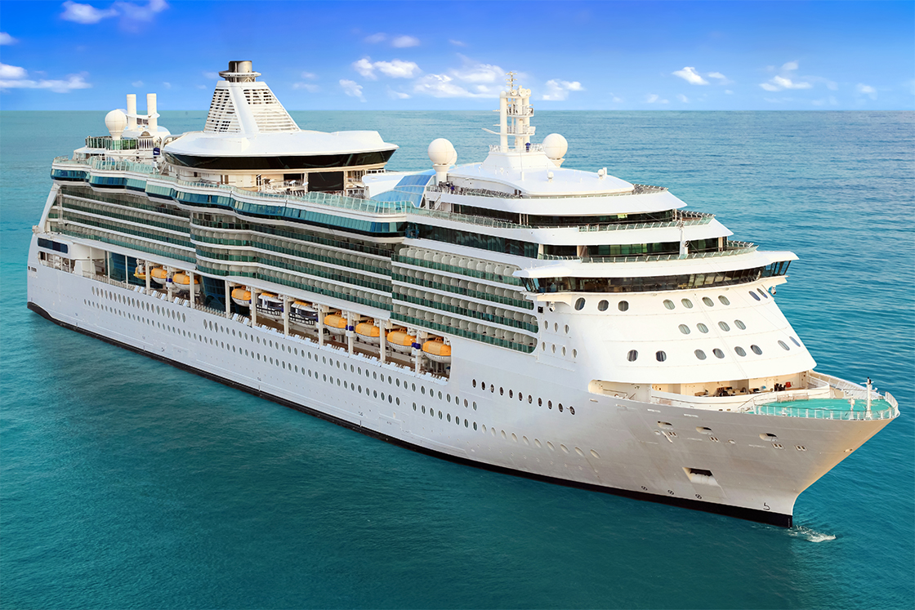
Only legally relevant issue—does a passenger liner qualifying as a military objective by use?
If so, it is liable to attack
But some States take the view that civilian passengers must be included in a collateral damage assessment
Notes:
The only legally relevant issue that may arise relates to a passenger liner qualifying as a lawful military objective by use. While it would then be liable to attack, some States are of the view that the civilian passengers on board specially protected vessels must be included in the collateral damage assessment. The classification of these passengers depends on the circumstances of the situation.

Slide 58
10.4 Specially Protected Vessels
SRM, Rule 170—”Hospital ships may be equipped with purely deflective means of defence, such as chaff and flares.”
Newport Manual 10.4.1.6.3—”…it is permissible to equip hospital ships with machine guns and other defensive weapons, if there are reasonable grounds for assuming that, in the circumstances ruling at the time, their protected status will be disregarded by the enemy or by non-State actors.”
Notes:
Passenger liners qualify as merchant vessels as defined in Chapter 3. If they have enemy character, they are liable to capture irrespective of the presence of civilian passengers on board. The only legally relevant issue that may arise relates to a passenger liner qualifying as a lawful military objective by use. While it would then be liable to attack, some States are of the view that the civilian passengers on board specially protected vessels must be included in the collateral damage assessment.683 The classification of these passengers depends on the circumstances of the situation.
However, such “purely deflective means” are not sufficient for an effective defense against terrorist or suicide attacks or other illegal attacks. Therefore, during the 2003 Iraq War, the USNS Comfort was equipped with .30-caliber and .50-caliber machine guns to fend off attacks by swarming, heavily armed speed boats or suicide craft.725 Since no State party to GC II protested those measures, it is safe to conclude that they have acquiesced in the U.S. practice. Accordingly, it is permissible to equip hospital ships with machine guns and other defensive weapons, if there are reasonable grounds for assuming that, in the circumstances ruling at the time, their protected status will be disregarded by the enemy or by non-State actors.

Slide 59
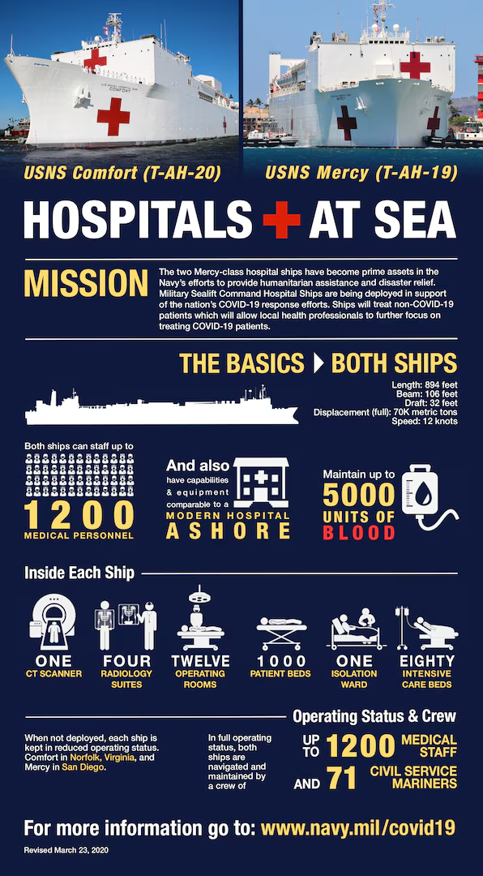
Hospital Ships—State Practice
During the 2003 Iraq War, the USNS Comfort was equipped with .30-caliber and .50-caliber machine guns to fend off attacks by swarming, heavily armed speed boats or suicide craft.
No State party to GC II protested those measures—acquiesced in the US practice

Slide 60
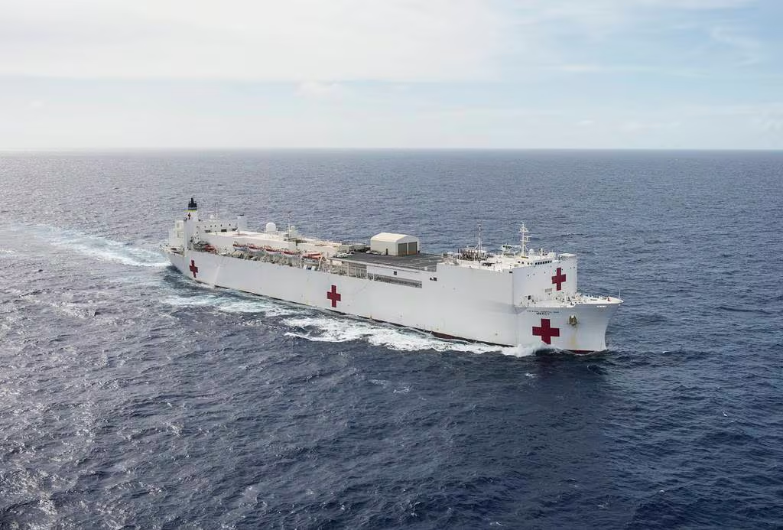
Hospital Ships—Current State Practice
GC II, art. 34(2)—”…hospital ships may not possess or use a secret code for their wireless or other means of communication.”
State Practice: “modern navigational technology requires the traditional rule prohibiting secret codes be understood to not include modern communications encryption systems.”
Hospital ships communicate via satellites by the use of encryption
Medical information of patients may also be encrypted or otherwise protected
“Such systems must not be used for military purposes in any way harmful to a potential adversary.”
Notes:
The third issue relates to the possession or use of a secret code for wireless or other means of communication that is prohibited under Article 34(2) of GC II. Whereas the English version of GC II seems to indicate that this prohibition is absolute, the equally authentic French version merely prohibits the possession or use of a secret code for the transmission of messages.727 Moreover, the provision must be interpreted considering the subsequent practice of the States party to GC II. Hospital ships communicate via satellites, thus by the use of encryption. Accordingly, “modern navigational technology requires the traditional rule prohibiting secret codes be understood to not include modern communications encryption systems.”728 Of course, “[s]uch systems must not be used for military purposes in any way harmful to a potential adversary.”729 The medical information of patients also may be encrypted or otherwise protected.

Slide 61
11 Maritime Neutrality
11.1 Definition of Neutrality
11.2 Neutrality and Jus ad Bellum
11.2.2 Qualified/Benevolent Neutrality
11.3 Belligerent Activities in Neutral Territory and Waters
11.4 Neutral Rights and Obligations

Slide 62
11.3.3.1 Self-Help
SRM Rule 22. Should a belligerent State be in violation of the regime of neutral waters … the neutral State is under an obligation to take the measures necessary to terminate the violation. If the neutral State fails to terminate the violation … by a belligerent, the opposing belligerent must so notify the neutral State and give that neutral State a reasonable time to terminate the violation …. If the violation … constitutes a serious and immediate threat to the security of the opposing belligerent and the violation is not terminated, then that belligerent may, in the absence of any feasible and timely alternative, use such force as is strictly necessary to respond to the threat posed by the violation.

Slide 63
11.3.3.1 Self-Help
SRM Rule 22 limitations are not reflective of State practice or opinion juris
“If a neutral State is unable or unwilling to enforce its neutrality, the aggrieved belligerent may take necessary measures in neutral territory, waters, and airspace to counter the acts of the enemy force, including the use of force.”
“In such case, there is no requirement that a belligerent first notify the neutral State and give the neutral State a reasonable time to terminate the violation of its neutrality by another belligerent before it can exercise the right of self-help.”

Slide 64
11.3.3.8 Neutral EEZs
SRM Rule 34: belligerents must have due regard for the resource rights of the neutral State when conducting hostilities in the EEZ or on the continental shelf.
SRM Rules 35: if a belligerent lays mines in a neutral State’s EEZ or continental shelf, the belligerent must notify the neutral State and ensure that the size of the minefield and the types of mines employed do not interfere with the neutral State’s resource rights.
SRM Rule 35: belligerents shall have due regard for the protection and preservation of the marine environment.
SRM lex ferenda requirements does not reflect the law of naval warfare as a lex specialis regime that displaces the law of the sea if the latter is inconsistent with the former

Slide 65
11.3.3.8 Neutral EEZs
Neutral State’s EEZ is not considered neutral waters
Belligerents may conduct hostilities and engage in other belligerent rights in the EEZ of neutral States
When conducting military operations in the EEZ and on the continental shelf, belligerents shall, consistent with military necessity and operational requirements, respect the rights and duties of neutral States
Example of State Practice: thousands of coalition offensive operations conducted from foreign EEZs into Afghanistan during Operation Enduring Freedom
Notes:
More recent examples
Coalition operations in the Red Sea against the Houthis
Coalition operations from the Mediterranean, Red Sea, and Gulf of Aden shooting down Iranian missiles and drones launched at Israel

Slide 66
11.4 Neutral rights and obligations
 | Neutral | Belligerent
Rights | Inviolability of commerce and territory | Insist upon neutral abstention and impartiality
Duties | Abstention and impartiality | Respect neutral inviolability of commerce and territory
Notes:
reciprocal rights and duties of neutrals and belligerents.
- Neutrals have the right to be inviolate in their territory, i.e., to be free of belligerent hostile activities.
Neutrals have the right to continue commerce, both with other neutrals and with belligerents.
Neutrals are required to abstain from participation in the conflict and to remain impartial.
- Belligerents have the right to insist that neutrals abstain from participation in the conflict and that they remain impartial.
Belligerents have the duty to respect the inviolability of neutral territory and the right of neutrals to engage in commerce.
- Impartiality is much of the problem in more modern times. Examples: (1) US providing munitions (transfer through private parties), etc., to Britain from 1939-1941; (2) US providing intelligence support and meteorological information to the UK during the Falklands/Malvinas conflict ; (3) Kuwait allowing transshipment of munitions and other war material across its territory to Iraq during the Iran/Iraq War of the 1980’s.
neutrality today may be refraining from active participation in the conflict.
In reality, belligerents decide whether they will treat a State as a neutral, and States not actively taking part in the conflict decide politically whether to provoke a belligerent by their actions. For example, Germany could have treated the 11.4 Neutral Rights and Obligations
11.4.1 Rights of Neutral States
11.4.1.1 Enforcing Neutrality
11.4.1.2 Closure of Ports and Roadsteads
11.4.1.3 Closure of Territorial Sea
11.4.2 Obligations of Neutral States
11.4.2.1 Impartiality
11.4.2.2 Abstention
11.4.2.3 Prevention
11.4.2.4 Fitting Out and Arming of Vessels
11.4.2.5 Prize
11.4.2.6 Detention of Belligerent Warships
11.4.2.7 International Straits and Archipelagic Waters

Slide 67
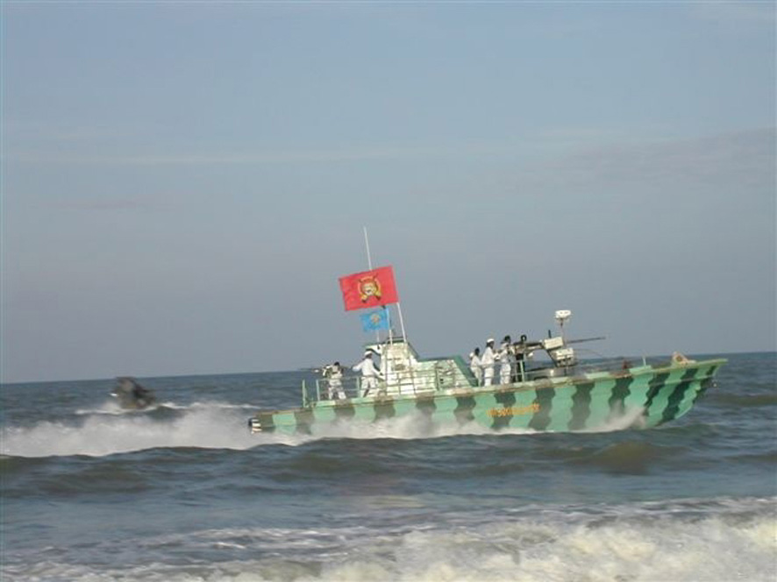
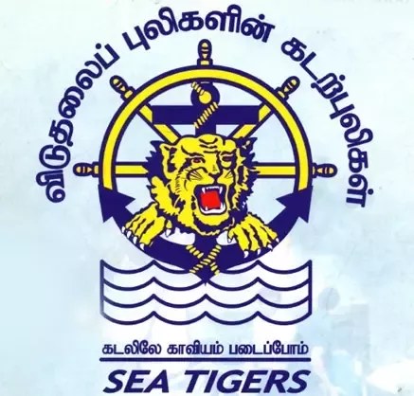
12 The Law of Naval Warfare and Non-International Armed Conflicts
Notes:
During a NIAC, neither prize law (chapter 9) nor the law of maritime neutrality (chapter 11) applies in the strict application of legal doctrine since these concepts historically were features of IAC.
If there is a recognition of belligerency of the non-State party to such conflict (LNW) applicable during IAC apply as between the relevant parties.
For example, during the Algerian conflict (1954-1962), France, as the State party to the conflict, visited, searched, and captured foreign merchant vessels far beyond the outer limit of the territorial sea.
During a non-international armed conflict, hostilities may extend beyond the outer limit of the territorial sea, whereas prize measures may not be taken. This applies to all parties to such an armed conflict. During the Spanish Civil War (1936-1939), foreign vessels and aircraft assisting the government forces were attacked by unknown military aircraft and submarines. During the armed conflict in Sri Lanka (1983-2009) between the government forces and the Liberation Tigers of Tamil Eelam (LTTE), both parties engaged in attacks against the enemy at sea and they also attacked and captured foreign vessels
12.3.1 No limitation of the exercise of belligerent rights to warships and military aircraft
The parties to a NIAC are not required to limit the exercise of hostile acts to warships and military aircraft as defined under the law of naval and aerial warfare. Accordingly, they may make use of any vessel or aircraft at their disposal for the purpose of engaging the respective enemy. See chapter 3.1.
12.3.4 Prohibited Attacks In a NIAC, indiscriminate attacks are prohibited
12.4 Protection of Victims Without prejudice to the peacetime duties to render assistance to those in distress at sea, the obligation to render assistance to wounded, sick, and shipwrecked amongst the parties in a NIAC is functionally the same as for IAC UNCLOS art. 98, SOLAS, SAR Convention, NWP 1-14M § 3.2.1.
12.1 Introduction
12.2 Geographical Scope of Applicability
12.3 Conduct of Hostilities
12.3.1 No limitation of the exercise of belligerent rights to warships and military aircraft
12.3.2 Limitation of Attacks against Persons and Objects Qualifying as Lawful Targets
12.3.2.1 Principle of Distinction
12.3.2.2 Lawful Targets in NIAC
12.3.2.2.1 Individuals
12.3.2.2.2. Objects
12.3.3 Prohibited Methods and Means of Warfare
12.3.3.1 Prohibited methods
12.3.3.2 Prohibited Means
12.3.4 Prohibited Attacks
12.4 Protection of Victims

Slide 68
12 The Law of Naval Warfare and NIAC
12.1 Introduction
12.2 Geographical Scope of Applicability
12.3 Conduct of Hostilities
12.4 Protection of Victims

Slide 69
12.1 Introduction
Parties to a NIAC are bound by the principles and rules on the conduct of hostilities and on the protection of victims of armed conflict
Customary LOAC rules that apply in all armed conflicts (e.g., principle of distinction) apply in NIACs at sea
Certain treaty obligations that apply to armed conflict generally (e.g., prohibition on the use of chemical weapons) apply in NIACs at sea
Neither prize law nor the law of maritime neutrality applies

Slide 70
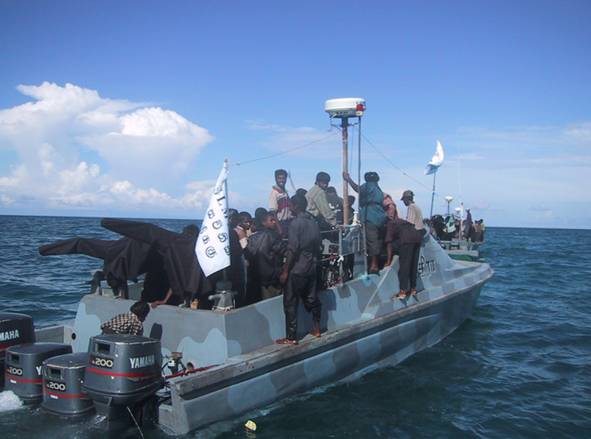
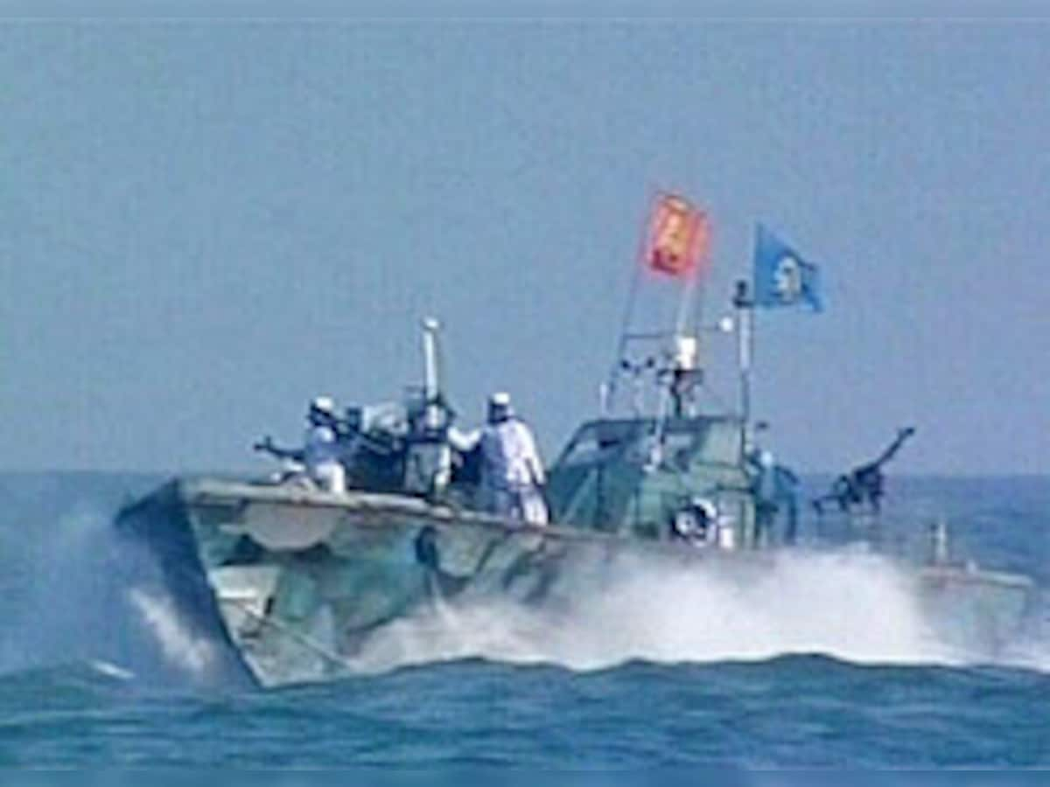
12.3 Conduct of Hostilities in NIAC
Attacks by the non-State party outside the territorial sea will qualify either as acts of piracy or as offenses under the Convention for the Suppression of Unlawful Acts Against the Safety of Maritime Navigation (SUA Convention)
Notes:
12.3.4 Prohibited Attacks In a NIAC, indiscriminate attacks are prohibited
12.4 Protection of Victims Without prejudice to the peacetime duties to render assistance to those in distress at sea, the obligation to render assistance to wounded, sick, and shipwrecked amongst the parties in a NIAC is functionally the same as for IAC UNCLOS art. 98, SOLAS, SAR Convention
12.3 Conduct of Hostilities
12.3.1 No limitation of the exercise of belligerent rights to warships and military aircraft
12.3.2 Limitation of Attacks against Persons and Objects Qualifying as Lawful Targets
12.3.2.1 Principle of Distinction
12.3.2.2 Lawful Targets in NIAC
12.3.2.2.1 Individuals
12.3.2.2.2. Objects
12.3.3 Prohibited Methods and Means of Warfare
12.3.3.1 Prohibited methods
12.3.3.2 Prohibited Means
12.3.4 Prohibited Attacks
12.4 Protection of Victims

Slide 71
Newport Manual (2d ed.) Workshop 17 May 2024
Chapter 2
2.4.1.4; 2.4.3
Chapter 3
3.2.1; 3.2.3
Chapter 4
4.1.1.4(1); 4.1.1.5; 4.1.2.1
Chapter 5
5.4; 5.5.1
Chapter 6
6.3; 6.3.1; 6.5; 6.11
Chapter 7
7.2.3; 7.4.5
Chapter 8
8.5.1.1; 8.5.1.2; 8.6.3(b); 8.6.8; 8.7.1; 8.8.1
Chapter 9
9.6; 9.9; 9.10
Chapter 11
11.3.3.6
Chapter 12
12.2

Slide 72
Welcome comments/critique.

