Slide 1
LEGAL OPERATIONS: LESSONS FROM GAZA
Aurel Sari

Slide 2
the plan…
Legal operations: a quick primer
Contested facts and law
Managing legal risk
Re-readings of the law
Implications

Slide 3
LEGAL OPERATIONS

Slide 4
A definition
law and military operations: two aspects
law as a normative framework for operations
law as a line of effort for military operations (instrument, method, object, medium)
SHAPE definition
legal operations involves the use of law as an instrument of power
encompasses actions by State and non-State actors aimed at gaining/undermining legitimacy, advancing/ undermining interests, or enhancing/denying capabilities

Slide 5
A legal operations perspective
hostile and friendly actors
how are they employing the law to achieve legal and operational effects?
what legal instruments are they using?
what objectives do they pursue?
how are they (pre)shaping the legal environment?
implications
how effective are hostile and friendly actors in using law for operational effects?
reaction: what are you going to do about it?

Slide 6
compliance
continued importance of law as a regulatory framework
a legal operations perspective does not to replace, but complements compliance
what lessons may be drawn from the Israel-Hamas conflict from a legal operations perspective?

Slide 7
CONTESTED FACTS AND LAW

Slide 8
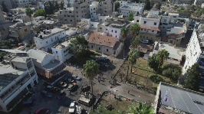
Facts are key
example: Al-Ahli Hospital Incident (17 October 2023)
explosion just outside the hospital
Gazan Ministry of Health: over 500 dead and injured
IDF: explosion caused by failed PIJ rocket
possible legal scenarios
IDF attack without hospital being military objective
IDF attack with hospital being military objective (precautions, proportionality)
IDF weapon malfunction (foreseeability?)
PIJ weapon malfunction (indiscriminate weapon?)
IDF interception of PIJ missile (foreseeability?)

Slide 9
Law is key
humanitarian aid if Israel not in occupation of Gaza
Article 23 GC IV
Each High Contracting Party shall allow the free passage of all consignments of medical and hospital stores …
The obligation of a High Contracting Party … is subject to the condition that this Party is satisfied that there are no serious reasons for fearing:
(a) that the consignments may be diverted from their destination,
(b) that the control may not be effective, or
(c) that a definite advantage may accrue to the military efforts or economy of the enemy
Article 70 AP I
1. If the civilian population of any territory under the control of a Party to the conflict, other than occupied territory, is not adequately provided with the supplies mentioned in Article 69, relief actions which are humanitarian and impartial in character and conducted without any adverse distinction shall be undertaken, subject to the agreement of the Parties concerned in such relief actions.

Slide 10
2. The Parties to the conflict and each High Contracting Party shall allow and facilitate rapid and unimpeded passage of all relief consignments, equipment and personnel provided in accordance with this Section, even if such assistance is destined for the civilian population of the adverse Party.
disputed facts: does Israel allow and facilitate?
if Israel is in occupation of Gaza
Article 55 GC IV
To the fullest extent of the means available to it, the Occupying Power has the duty of ensuring the food and medical supplies of the population; it should, in particular, bring in the necessary foodstuffs, medical stores and other articles if the resources of the occupied territory are inadequate.
Article 69 AP I
1. In addition to the duties specified in Article 55 of the Fourth Convention concerning food and medical supplies, the Occupying Power shall, to the fullest extent of the means available to it and without any adverse distinction, also ensure the provision of clothing, bedding, means of shelter, other supplies essential to the survival of the civilian population of the occupied territory and objects necessary for religious worship.
less of a dispute over the facts: Israel unlikely to be in compliance

Slide 11
MANAGING LEGAL RISK

Slide 12
The principle of distinction
very extensive destruction across Gaza
IDF response: only targeting military objectives
permissive rules: definition of military objectives
Article 52(2) API
Attacks shall be limited strictly to military objectives. In so far as objects are concerned, military objectives are limited to those objects which by their nature, location, purpose or use make an effective contribution to military action and whose total or partial destruction, capture or neutralization, in the circumstances ruling at the time, offers a definite military advantage.
‘use’ and ‘purpose’ in an urban environment
scope for ‘foreward leaning’ interpretations
multistorey and other complex buildings

Slide 13
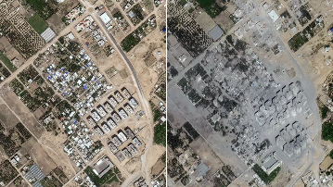
‘non-attack’ damage to objects in control
destruction of agricultural land, bulldozing of buildings etc
Article 23(g) Hague Regulations
…it is especially forbidden
(g) To destroy or seize the enemy's property, unless such destruction or seizure be imperatively demanded by the necessities of war;
dilemma
LOAC potentially very permissive in an urban environment
‘forward leaning’ application/interpretation may justify extensive destruction
even discriminating attacks may lead to ‘carpet bombing’ effect
disconnect between law and perception

Slide 14
Proportionality
proportionality
Article 51(5) API
Among others, the following types of attacks are to be considered as indiscriminate:
(b) an attack which may be expected to cause incidental loss of civilian life, injury to civilians, damage to civilian objects, or a combination thereof, which would be excessive in relation to the concrete and direct military advantage anticipated.
overall level of civilian harm in Gaza is very high
proportionality applies to individual ‘attacks’: could individual strikes be compliant?
comparison with other campaigns: CIVCAS substantially higher than Iraq or Afghanistan
COIN hangover or sign that IDF takes CIVCAS to ‘excessiveness’ levels?

Slide 15
example: allegations about ‘Lavender’ AI system
AI system assisting in generating human targets
allegation: 15-20 CIVCAS for junior Hamas operative; over 100 CIVCAS for battalion/brigade commander
excessive?

Slide 16
RE-READINGS OF THE LAW

Slide 17
From ‘hot takes’ to ‘fake law’?
proliferation of legal ‘hot takes’
often without adequate knowledge of facts
proliferation of re-readings of the law
misinformation, ignorance or deliberate reinterpretation?
target verification an obligation of process, not end result
‘actual knowledge’ vs ‘reasonable certainty’

Slide 18
‘artillery in urban environment per se indiscriminate’
‘purpose’ in Article 52(2) API refers to design or intended purpose of object, not how enemy intends to use it
i.e. civilian object qualifies as military objective only if in current use, not based on future intended enemy use

Slide 19
Some thoughts on Dr Gurmendi
a selective reading of history and the law
the Brussels Declaration 1874: undefended v. defended localities for bombardment
1899 and 1907 Hague Regulations: Article 25 (undefended localities) and Article 27 (precautionary obligations for certain objects)
1907 Hague Convention IX: naval bombardment of undefended localities prohibited (Article 1), but certain objects of military value not included (Article 2)
impact of Hague Air Rules of 1923: switch to ‘miliary objective’-point targeting; proportionality for incidental civilian harm; precuationary duties

Slide 20
a selective re-reading of the law
is it possible? sure, let’s have ‘law of war’ without the ‘war’ bit
does it reflect the law as it stands? no: see drafting history of proportionality in API
is it desirable? no, because an overly ambitious LOAC will not command compliance

Slide 21
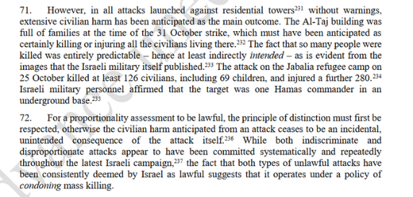
This does grow legs...
if (a) civilian harm is almost certain (b) quantitatively higher than number of military objectives affected, then it is intended and not incidental (therefore indiscriminate and outside scope of proportionality)

Slide 22
IMPLICATIONS

Slide 23
Risks, challenges, vulnerabilities
compliance and legitimacy
compliance seen as a key aspect of legitimacy (‘campaign authority’)
loss of legitimacy has costs: political, legal, operational
social media amplifies wildly divergent claims about facts and the law
immense volume, many platforms, vast tempo
aspect of ‘participatory warfare’

Slide 24
spread of ‘fake law’ and reinterpretations
widespread legal revisionism
even if States comply with LOAC as they understand it, are they being held to account to different standard?
long-term consequences?
heightened risk of lawfare
likelihood of legal challenges (cf. South Africa v. Israel; legal challenges to weapon supplies)
will adversaries exploit ‘useful idiots’ and domestic discontent?
level of challenge
think peer-to-peer and sophisticated adversary

Slide 25
What now?
overriding need to respond
States (and forces) must engage in proactive perception management of facts and the law
link between law and strategic communication
short-term and long-term challenges
home and foreign audiences
how to respond?
who, how, what, when?

Slide 26
some lines of effort
situational awareness: legal vigilance
preparedness: shaping the legal battlefield
operational capacity: ability to conduct legal operations
national and alliance level (more robust coopration and increasing legal interoperability)

