Slide 1
CRITICAL OFF-SHORE ENERGY INFRASTRUCTURE PROTECTION IN BALTIC SEA REGION
Lithuanian Navy, SCSS, LCDR Jevgenij Vidiajev

Slide 2
AGENDA
Infrastructure vulnerabilities
Baltic Sea environment and trends
COHERENT RESILIENCE 2023 Exercise findings
Legal aspects
Critical energy infrastructure protection in Lithuania (Maritime domain)

Slide 3
INFRASTRUCTURE VULNERABILITIES
PEACE
CRISIS
WAR
Natural disasters (hurricanes, floods etc.)
Human factor (anchor dragging, fishing trawlers, unlawful actions)
Technical issues (windmill crash, fires etc.)
Terrorism
Non-friendly state actors (hidden actions)
War related actions
INFRASTRUCTURE OPERATORS
LAW ENFORCEMENT ENTITIES
ARMED FORCES (NAVY, AIR FORCE)

Slide 4
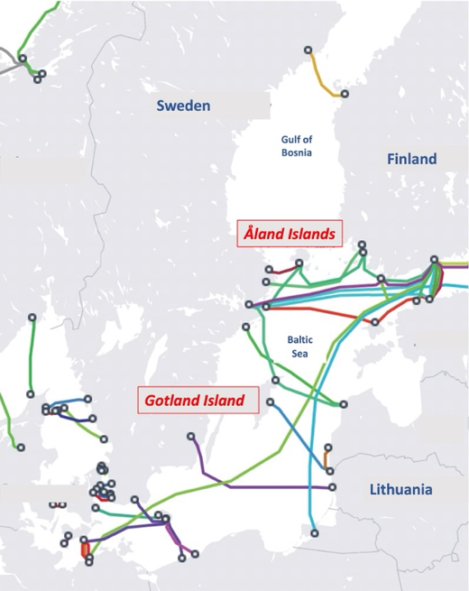
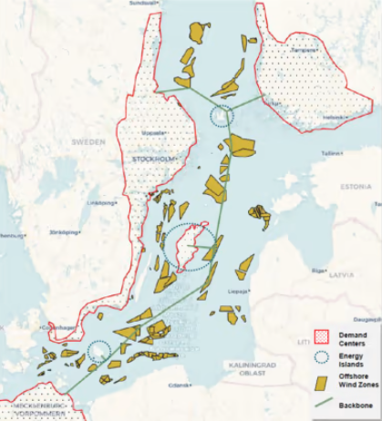
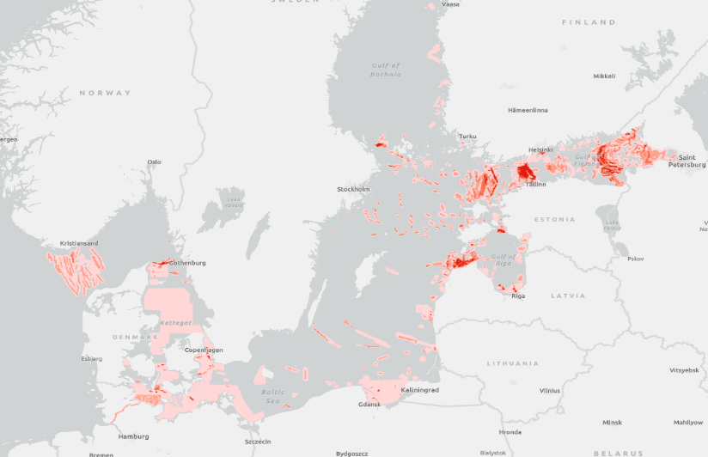
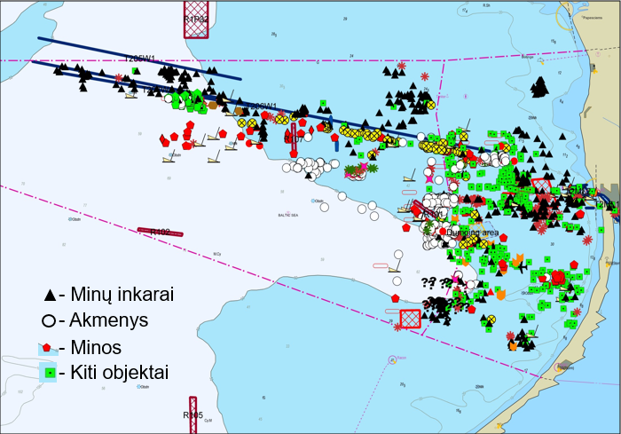
ENVIRONMENT & TRENDS
Rapid expansion of energy infrastructure in Baltic Sea region
Russian – EU/NATO tension
High economic activity (traffic density)
Historical heritage (mines, chemical weapon dumping grounds)
Mines

Slide 5
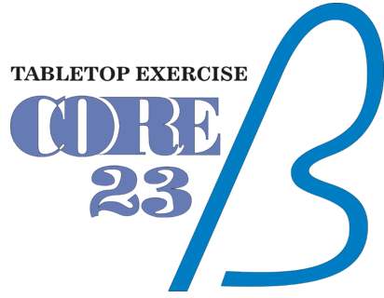
COHERENT RESILIENCE 2023 Ex FINDINGS
Energy infrastructure vulnerable
Attack surface too wide to protect everything
Identify critical energy infrastructure protection priorities
Quick and secure communications between operators and security actors
Operators have limited authority to enhance security

Slide 6
COHERENT RESILIENCE 2023 TAKE AWAYS
New mindsets that build-in security and protection of energy infrastructure from the outset
Preparedness is key. Frameworks, plans and points of contact
Roles and responsibilities clear
Identification and detection. Surveillance and monitoring
Understand the threat. Identify necessary capabilities. Ensure authorities
Cooperation arrangements between operators and governments through peacetime, crisis and conflict

Slide 7
LEGAL ASPECTS
Territorial Sea
12nm from a coastal State’s baselines
Sovereignty of the coastal State (!! Innocent passage of other States)
Exclusive Economic Zone
Up to 200 nm from a coastal State’s baselines
Sovereign rights relating to:
construct and operate artificial installations and structures, as well as establishing safety zones to protect them (500 m.) (Art. 60 UNCLOS)
NOT submarine cables and pipelines passing through a coastal State’s EEZ (only the flag State, Art. 113 UNCLOS)
24/7 surveillance + authority
LESS surveillance + LESS authority + LESS assetts able to operate off shore

Slide 8
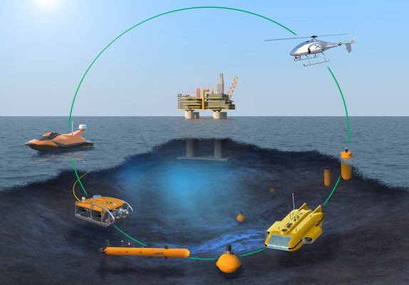
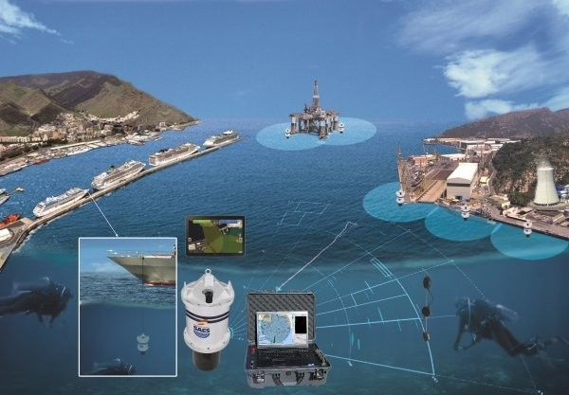
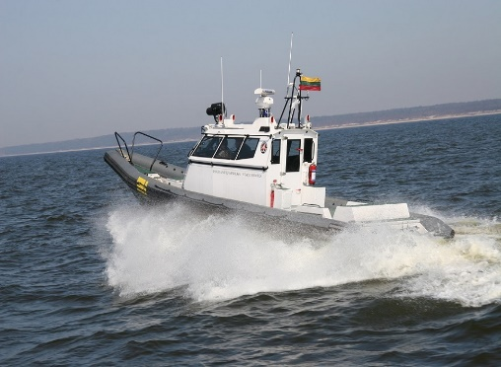
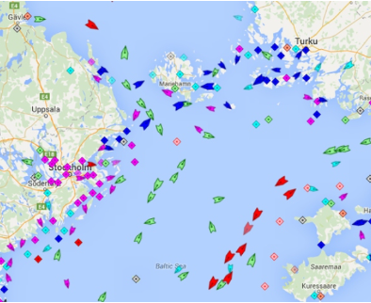
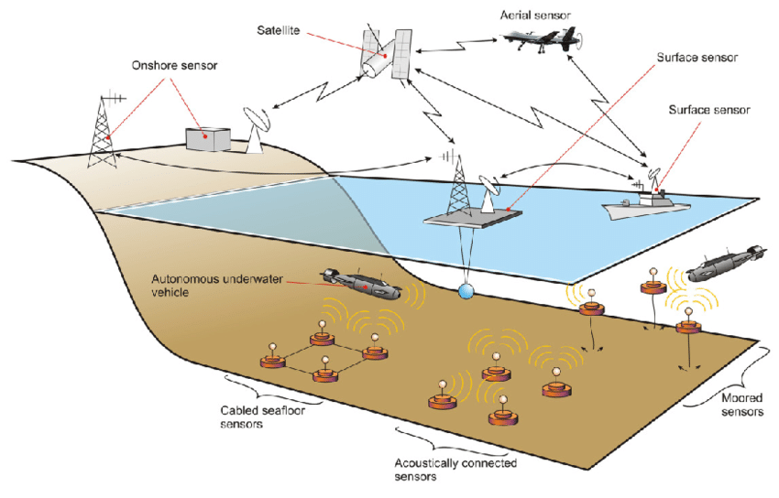
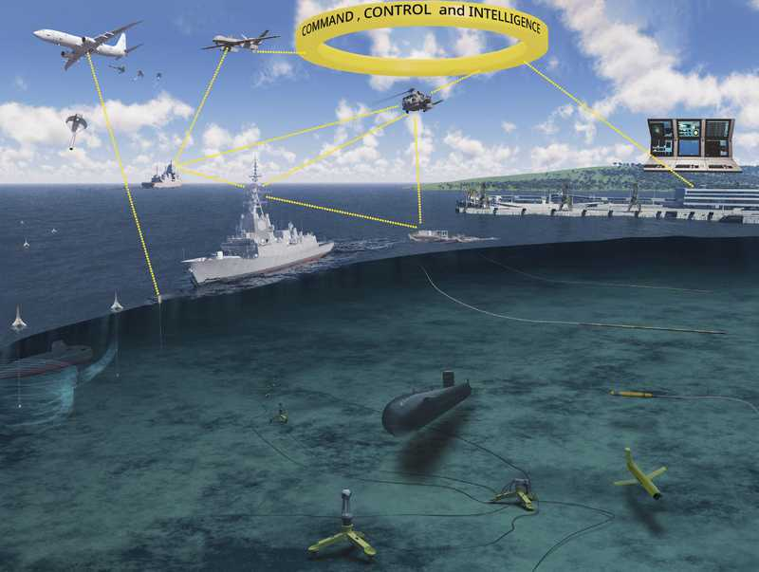
CRITICAL ENERGY INFRASTRUCTURE PROTECTION IN LTU
INTERNATIONAL PARTNERS
Physical protection/Monitoring
Operators
OPERATORS
COORDINATION
Security/Policing
Government entities
CONSTABULARY ENTITIES
STANDING PLANS
MARITIME SITUATIONAL AWARENESS
Defense
Naval FORCES
ALLIES AND PARTNERS

Slide 9
QUESTIONS

